Slide 1
Artist 17

Slide 2
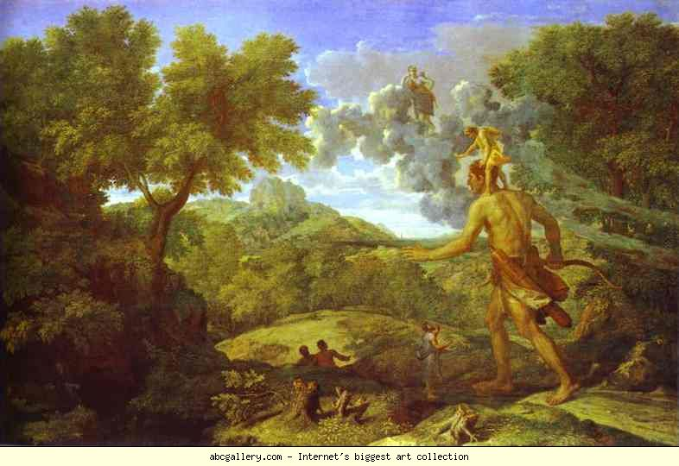
1

Slide 3
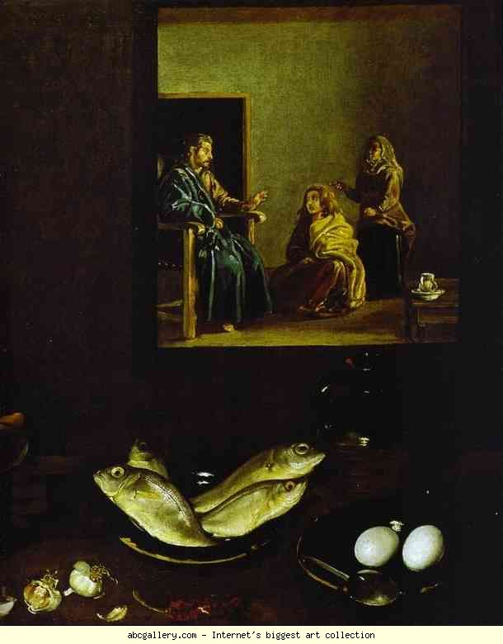
2

Slide 4
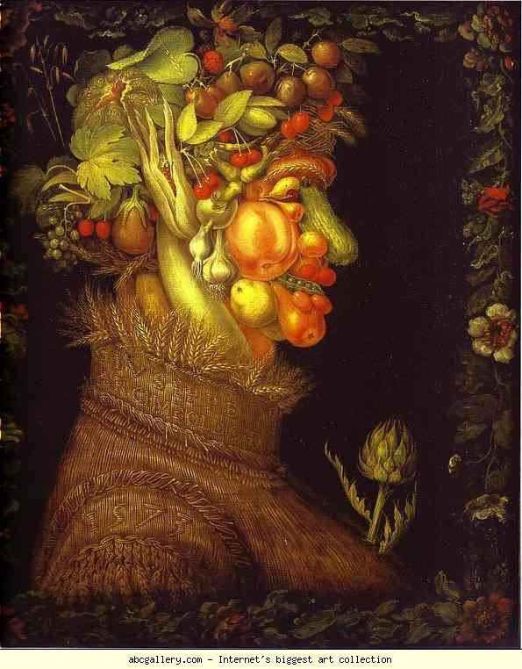
3

Slide 5
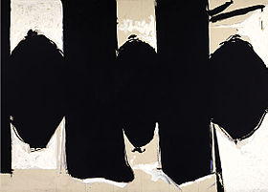
4

Slide 6
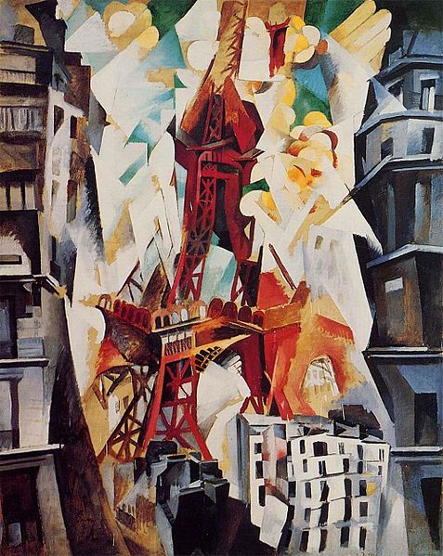
5

Slide 7
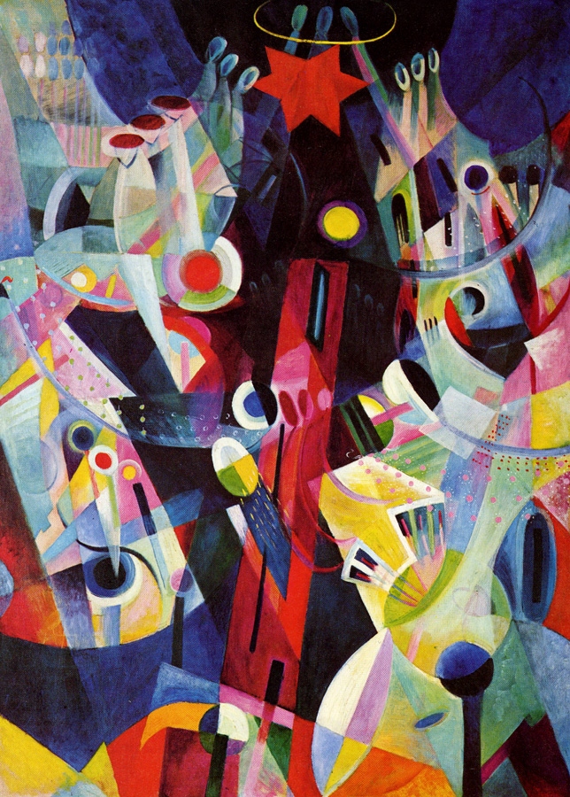
6

Slide 8
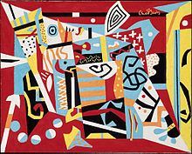
7

Slide 9
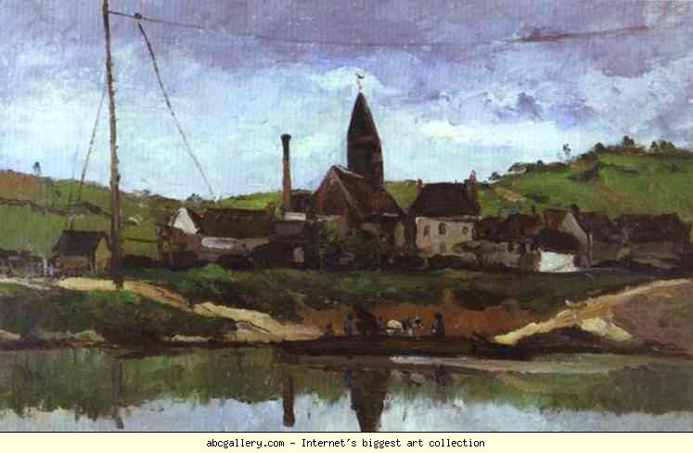
8

Slide 10
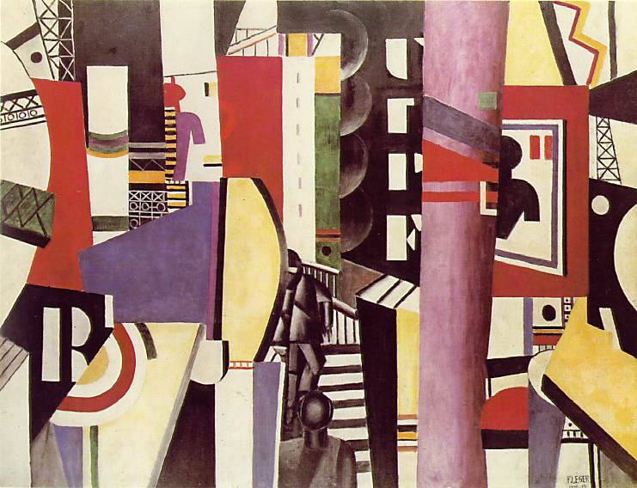
9

Slide 11
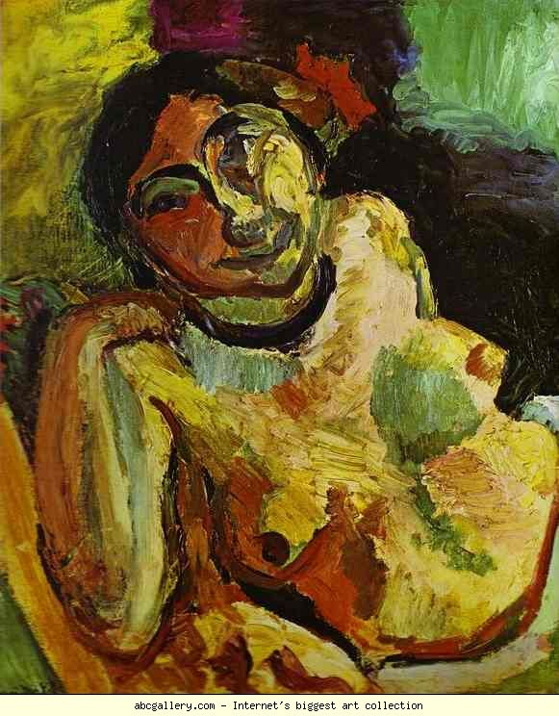
10

Slide 12
Nicolas Poussin. Landscape with the Blind Orion Looking for Sun. 1658. The Metropolitan Museum of Art, New York, USA
Diego Velαzquez. Christ in the House of Martha and Mary. Detail. 1618. Oil on canvas. National Gallery, London, UK.
Giuseppe Arcimboldo. Summer. 1573. Oil on canvas. Louvre, Paris, France
Robert Motherwell Elegy to the Spanish Republic No. 110,
1971
Robert Delaunay Champs de Mars. La Tour rouge.1911. Art Institute of Chicago.
Itten, The Red Tower, 1918
Stuart Davis Hot Still-Scape for Six Colors - 7th Avenue Style, 1940, Boston Museum of Fine Arts
Paul Cézanne. View of Bonnières. 1866. Musée Faure, Aix-les-Bains, France
Fernand Léger The City, 1919, oil on canvas, The Philadelphia Museum of Art, A. E. Gallatin Collection
Henri Matisse. Gypsy. 1906. Oil on canvas. Musιe de l'Annonciade, Saint-Tropez, France

