Slide 1
Artists 10

Slide 2
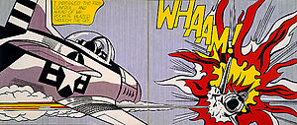
1

Slide 3
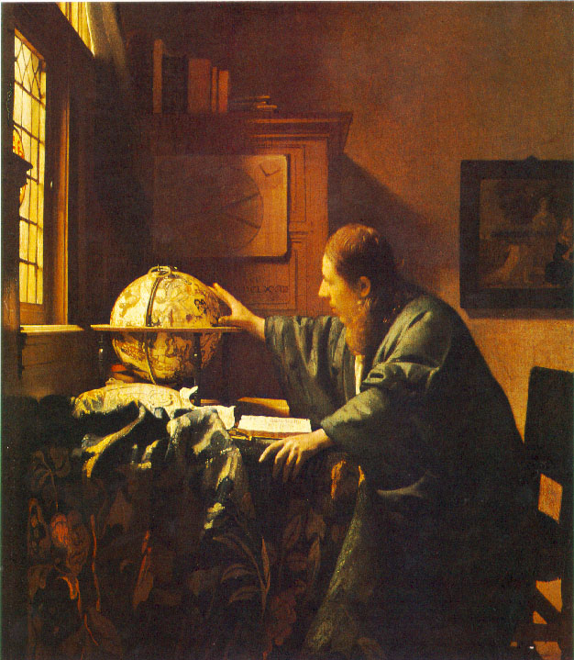
2

Slide 4
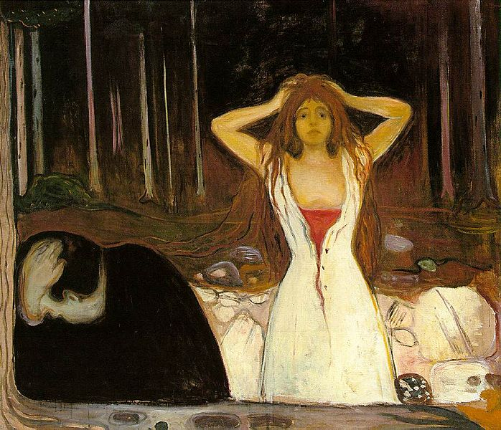
3

Slide 5
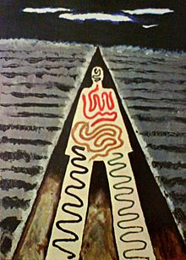
4

Slide 6
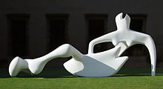
5

Slide 7
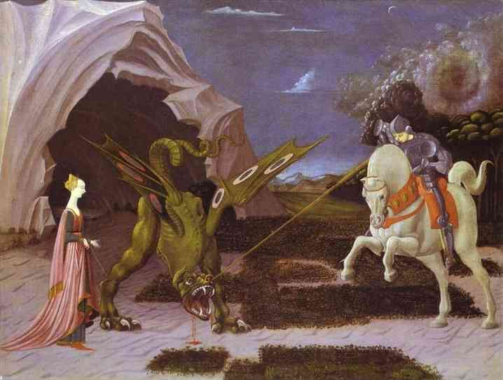
6

Slide 8
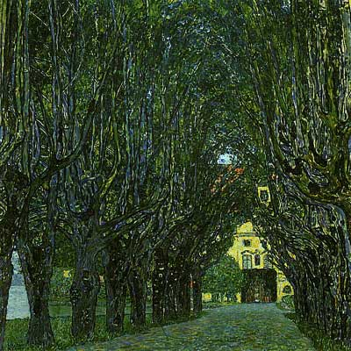
7

Slide 9
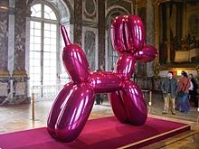
8

Slide 10
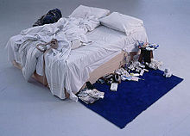
9

Slide 11
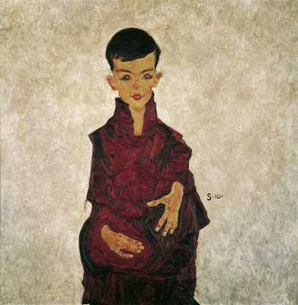
10

Slide 12
Roy Fox LichtensteinWhaam!, 1963, 1.7 x 4.0 m Tate Modern
Vermeer: The Astronomer (1668) - Louvre, Paris
Edvard MunchAshes. 1894. Oil on canvas. 120.5 × 141 cm. Nasjonalgalleriet, Oslo
Man RayA Night at Saint Jean-de-Luz(1929).
Collection of the Modern Art Museum of the City of Paris
Henry Moore Reclining Figure (1951), Fitzwilliam Museum, Cambridge
Paolo Uccello: San Giorgio e il Dragone - National Gallery, London
Klimt: Avenue Schloss Kaven (1912) - Belvedere, Wien
Jeff Koons Balloon Dog (Magenta), 1994-2000, mirror-polished stainless steel with transparent color coating, 307.3 x 363.2 x 114.3 cm,François Pinault Foundation
Tracey Emin My Bed, 1999. Tate Gallery
Schiele: Rainerbub (1910) - Belvedere, Wien

