Slide 1
Artists 11

Slide 2
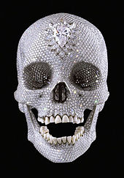
1

Slide 3
2

Slide 4
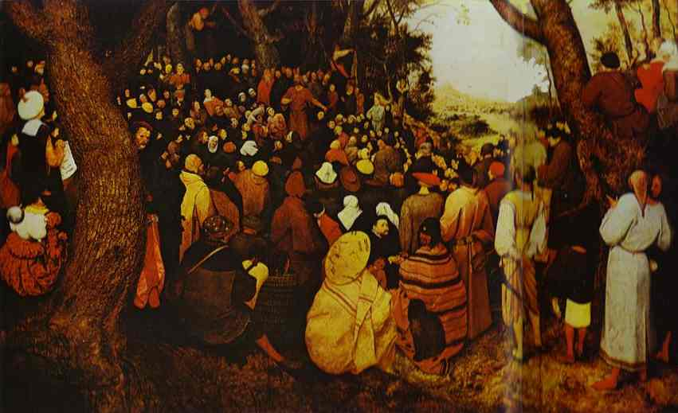
3

Slide 5
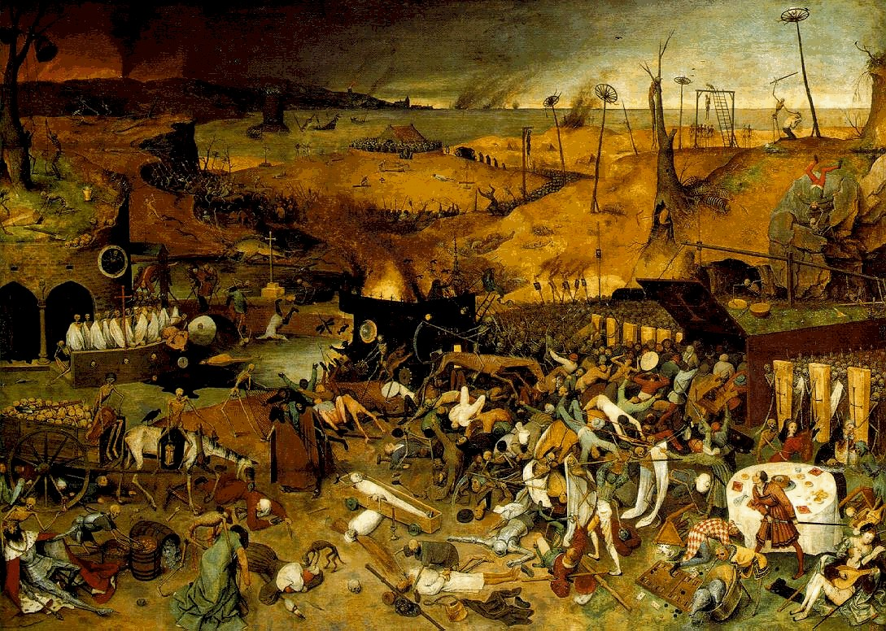
4

Slide 6
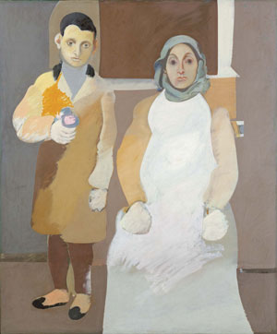
5

Slide 7
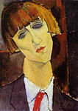
6

Slide 8
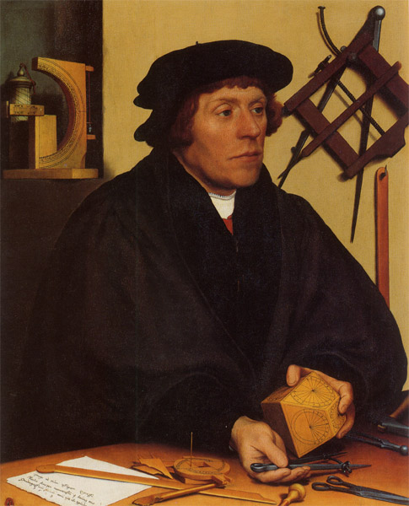
7

Slide 9
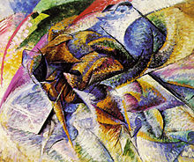
8

Slide 10
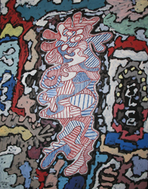
9

Slide 11
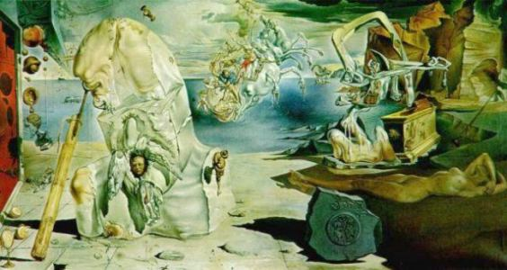
10

Slide 12
Damien Hirst For the Love of Go 2007
Yves Klein, IKB 191, 1962.
Bruegel: Sermon of St John 1566, Szepmuveszen Muzeum, Budapest
Bruegel: Triumph of Death (15??) - Museum fur Gegenwartskunst, Basel
Arshile Gorky The Artist and His Mother (ca. 1926–1936), Whitney Museum of American Art, New York City
Modigliani Madame Kisling, 1917
Holbein: Nikolaus Kratzer 1528 - Louvre, Paris
Umberto Boccioni Dynamism of a Cyclist, 1913
Jean Dubuffet, Court les rues, 1962, Milwaukee Art Museum, Milwaukee
, Dali: Apoteosis of Homer, Staatsgalerie Moderner Kunst, Munchen

