Slide 1
Artists 12

Slide 2
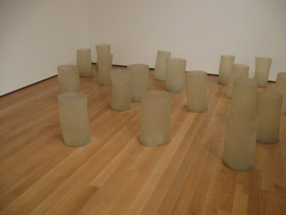
1

Slide 3
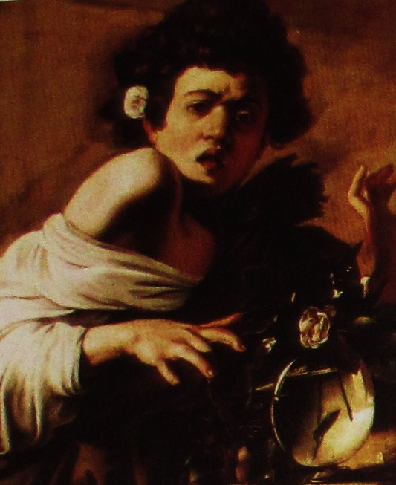
2

Slide 4
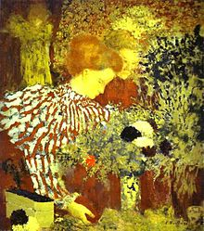
3

Slide 5
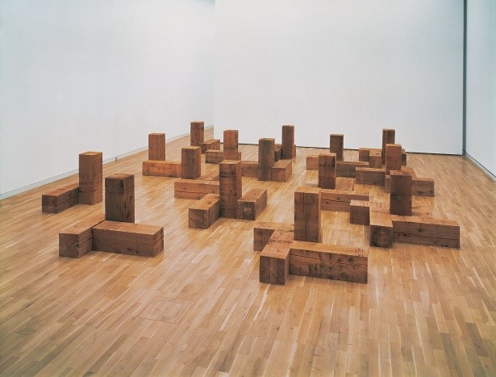
4

Slide 6
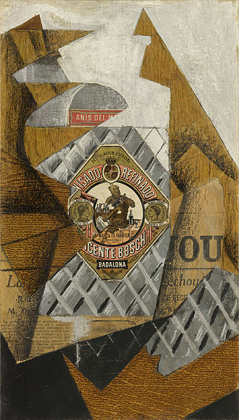
5

Slide 7
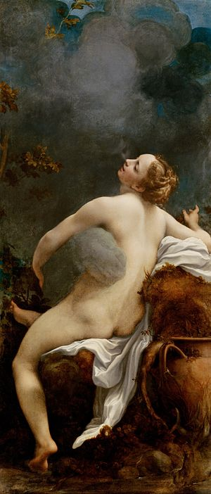
6

Slide 8
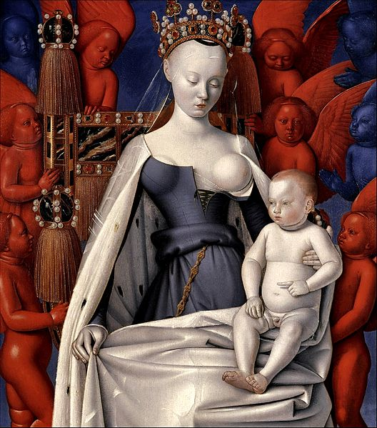
7

Slide 9
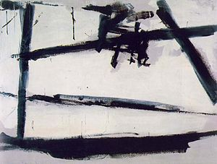
8

Slide 10
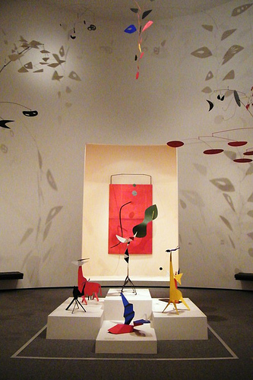
9

Slide 11
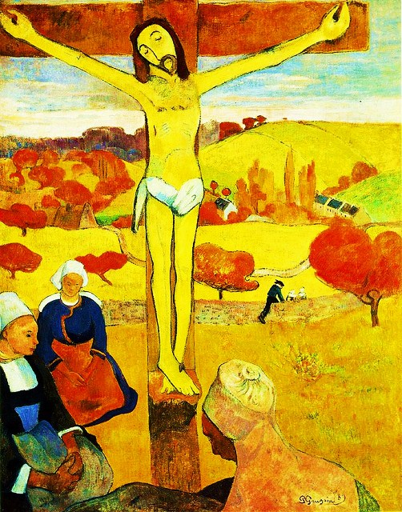
10

Slide 12
Eva Hesse Repetion 19, III, 1968, fiberglass and polyester resin,Museum of Modern Art, New York
Caravaggio Boy Bitten by a Lizard c.1594
Édouard VuillardLe corsage rayé, 1895, National Gallery of Art, Washington D.C.,
Carl Andre Uncarved Blocks, Vancouver 1975 47 Blöcke, je 30 x 30 x 90 cm Gesamtmaße variabel
Juan Gris The Bottle of Anís del Mono, 1914, Queen Sofia Museum, Madrid, Spain
Antonio da Correggio1532–1533,163.5 cm × 70.5 cm Kunsthistorisches Museum
Jean Fouquet Right wing of Melun Diptych; Virgin and Child Surrounded by Angels, showing Charles VII's mistress Agnès Sorel(c.1450) Wood, 93 x 85 cm,Royal Museum of Fine Arts, Antwerp.
Franz Jozef Kline Painting Number 2, 1954,The Museum of Modern Art
Alexander Calder Calder Room, National Gallery of Art, Washington, D.C.
Paul Gauguin The Yellow Christ c.1889

