Slide 1
Artists 14

Slide 2
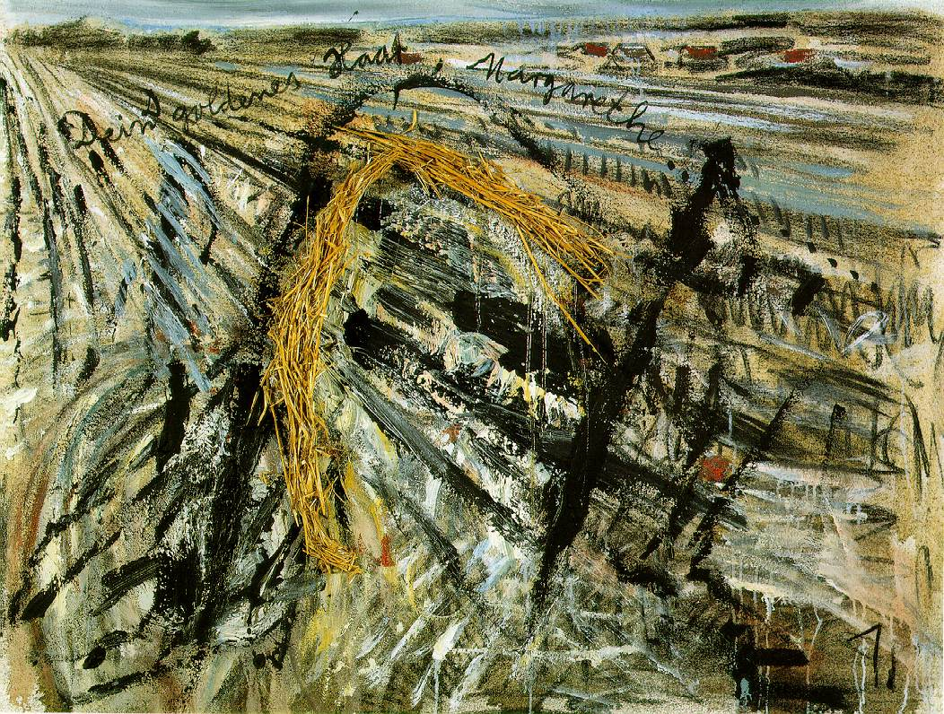
1

Slide 3
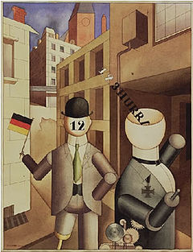
2

Slide 4
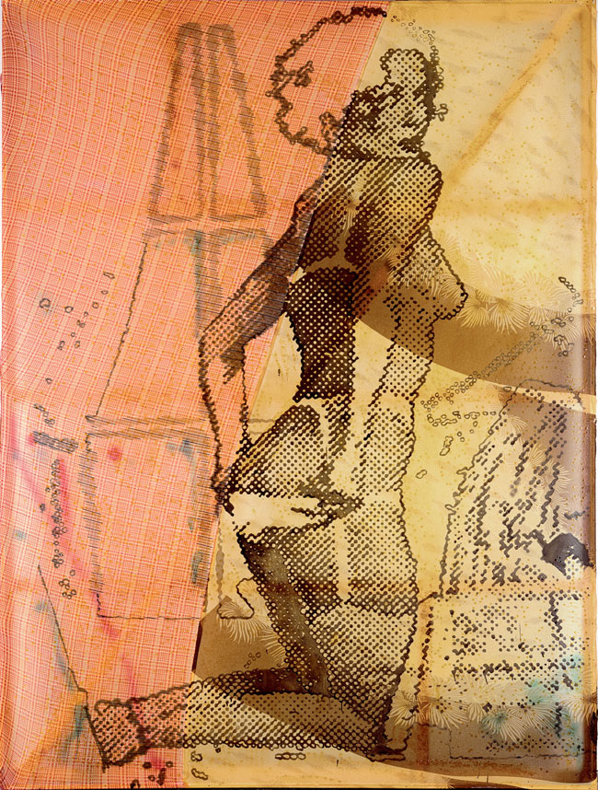
3

Slide 5
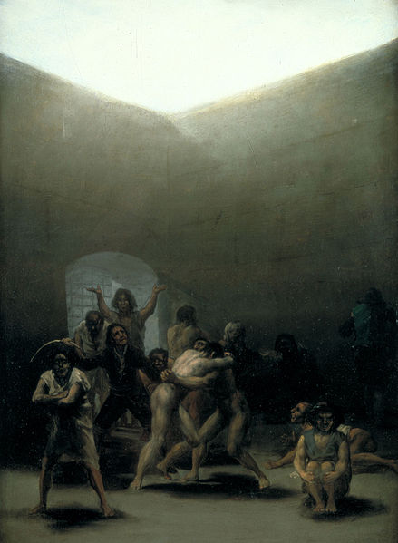
4

Slide 6
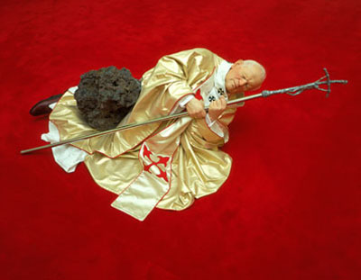
5

Slide 7
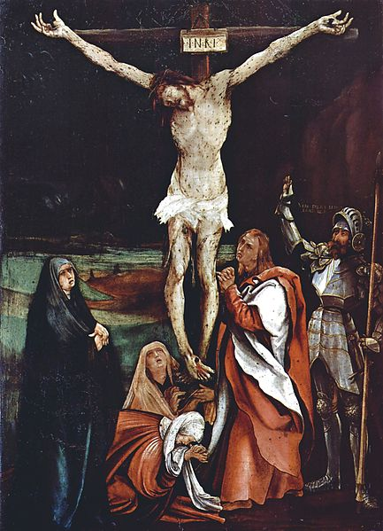
6

Slide 8
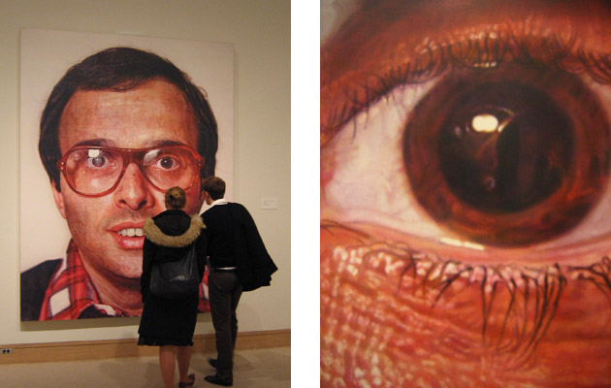
7

Slide 9
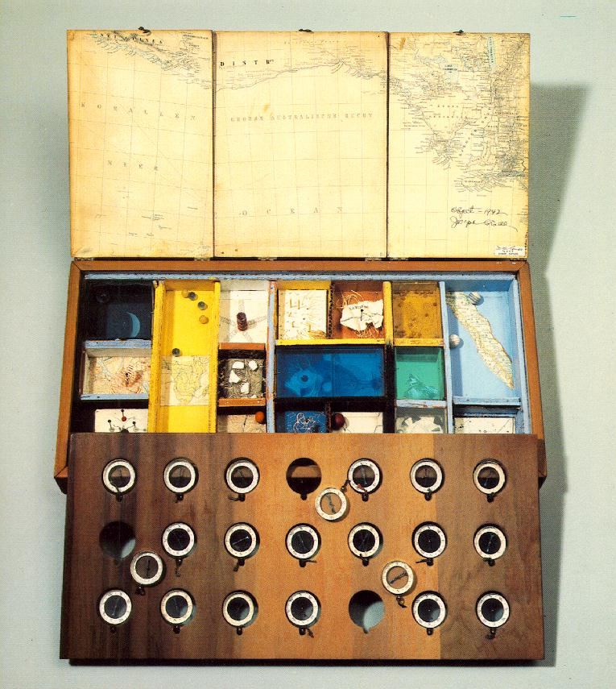
8

Slide 10
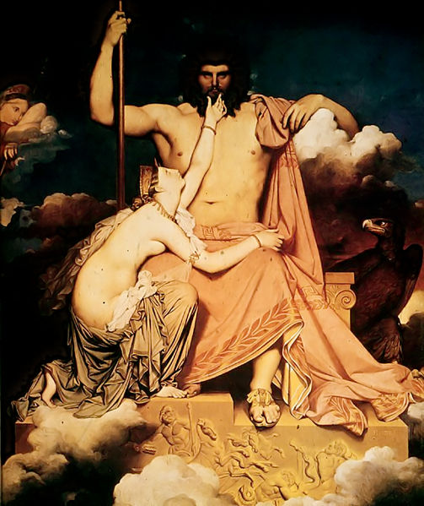
9

Slide 11
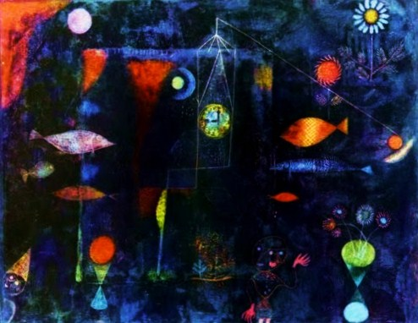
10

Slide 12
Anselm Kiefer Your Golden Hair, Margarete
1981 Oil, emulsion, and straw on canvas, 130 x 170 cm Collection Sanders, Amsterdam
George GroszRepublican Automatons, 1920, watercolor on paper, Museum of Modern Art, New York
Sigmar Polke, B-Mode 1987, Lack auf synthetischer Baumwolle, Museum Frieder Burda, Baden-Baden
Goya Yard with Madmen 1794,43.8 × 32.7 cm Meadows Museum
Maurizio Cattelan La nona ora 1999
Matthias Grünewald Crucifixion 1500-1508 Kunstmuseum Basel.
Chuck Close Mark 1978–1979 Metropolitan Museum of Art, New York, New York; detail at right of eye
Joseph Cornell, Object (Roses des Vents) 1942-53 Construction, 2 5/8 x 21 1/4 x 10 3/8 The Museum of Modern Art, New York
Ingres Jupiter and Thétis 1811 Musée Granet
Paul Klee Fish Magic 1925Philadelphia Museum of Art, Philadelphia, PA, USA

