Slide 1
Artists 15

Slide 2
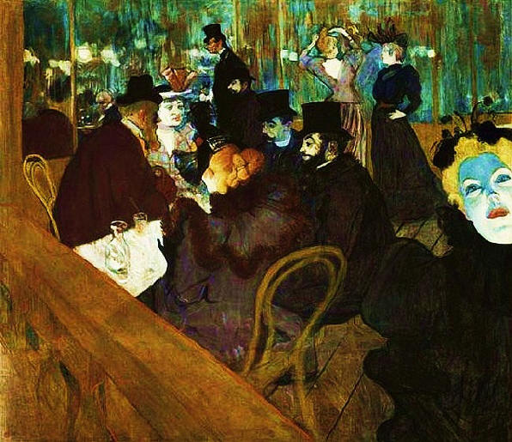
1

Slide 3
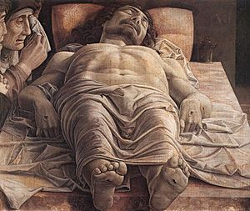
2

Slide 4
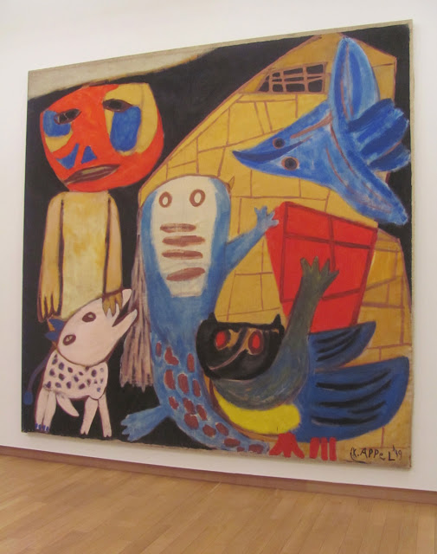
3

Slide 5
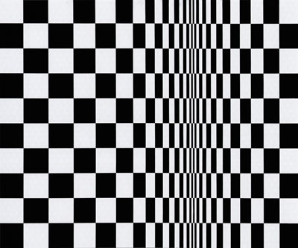
4

Slide 6
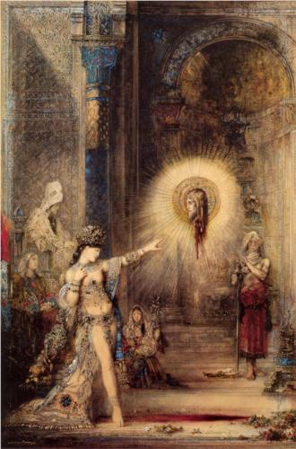
5

Slide 7
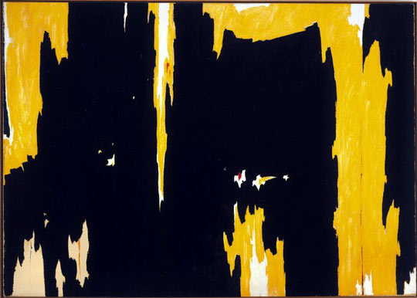
6

Slide 8
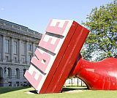
7

Slide 9
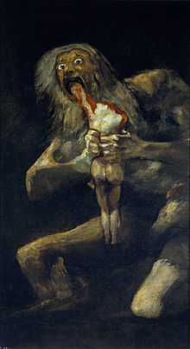
8

Slide 10
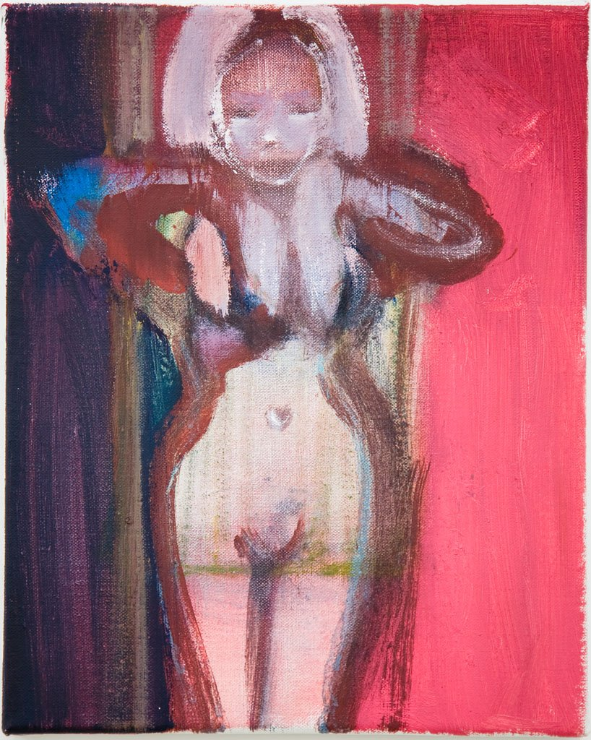
9

Slide 11
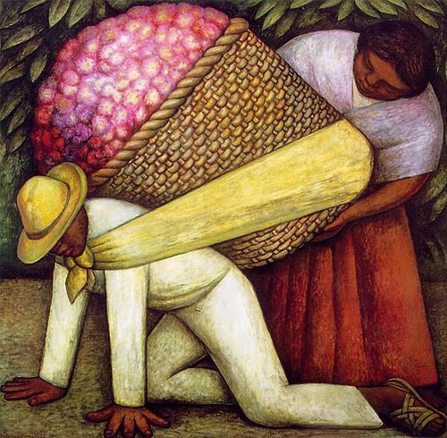
10

Slide 12
Henri de Toulouse-Lautrec At the Moulin Rouge .1895Philadelphia Museum of Art, Philadelphia, PA, USA
Andrea MantegnaThe Lamentation over the Dead Christ1480 68 cm × 81 cm Pinacoteca di Brera, Milan
Karel Appel, "Man and Animals," 1949 Stedelijk Museum, Amsterdam
Bridget Louise Riley Movement in Squares, 1961.Goldsmiths College, Royal College of Art
Gustave Moreau The Apparition 1876Musée du Louvre, Paris, France
Clyfford Still, D No. 1, 1957, 113 x 159 in, Albright-Knox Art Gallery, Buffalo, New York
Claes Oldenburg "Free" Stampat Cleveland City Hall
Goya Saturn Devouring His Son,1819–1823. 143cm x 81cm. Museo del Prado, Madrid
Marlene Dumas, The Pleasure Principal, 1999, Oil on canvas, 30 x 24 cm
Diego Rivera The Flower Carrier 1935

