Slide 1
Artists 18

Slide 2
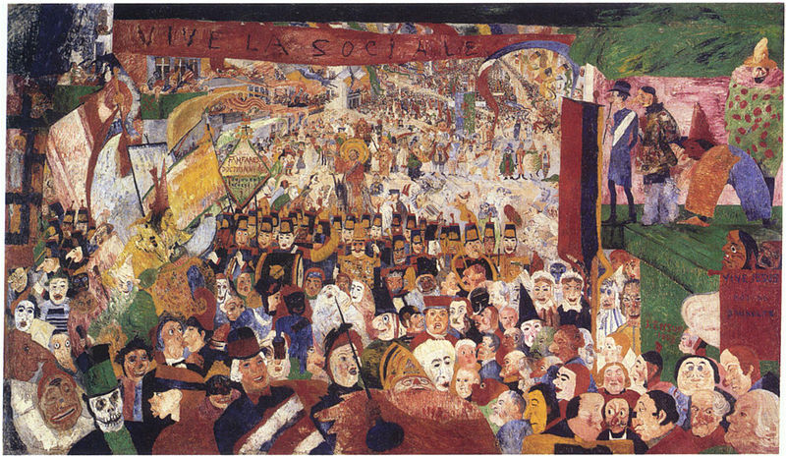
1

Slide 3
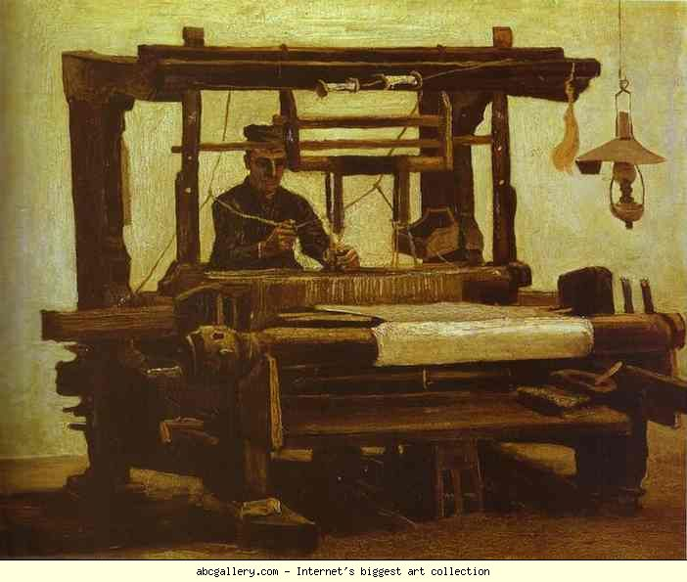
2

Slide 4
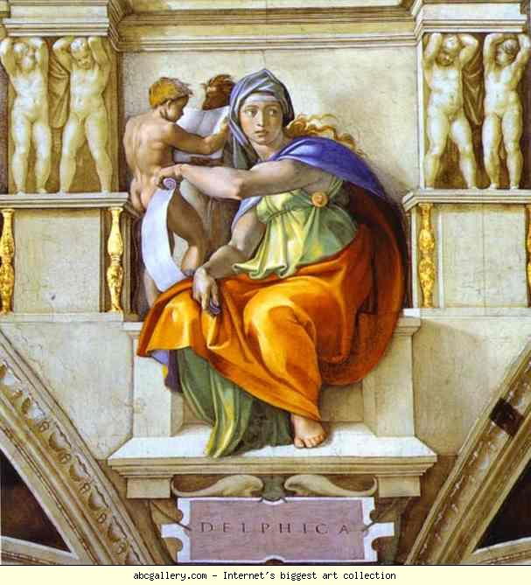
3

Slide 5
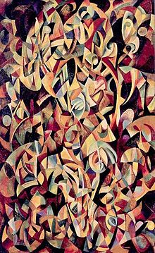
4

Slide 6
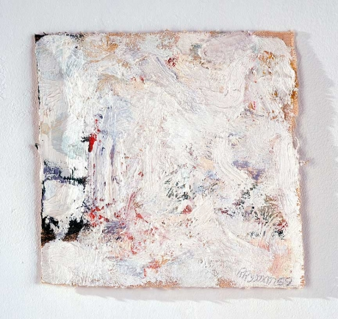
5

Slide 7
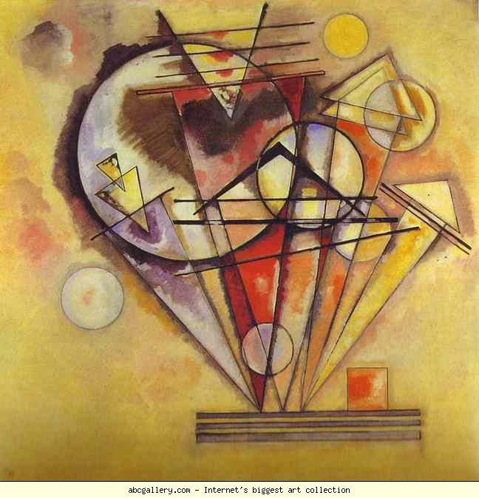
6

Slide 8

7

Slide 9
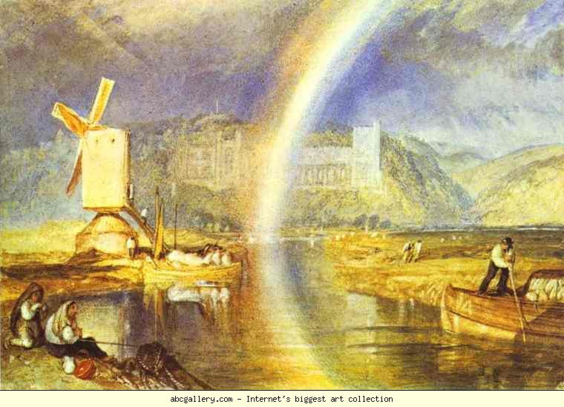
8

Slide 10
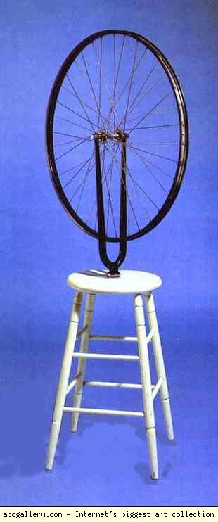
9

Slide 11
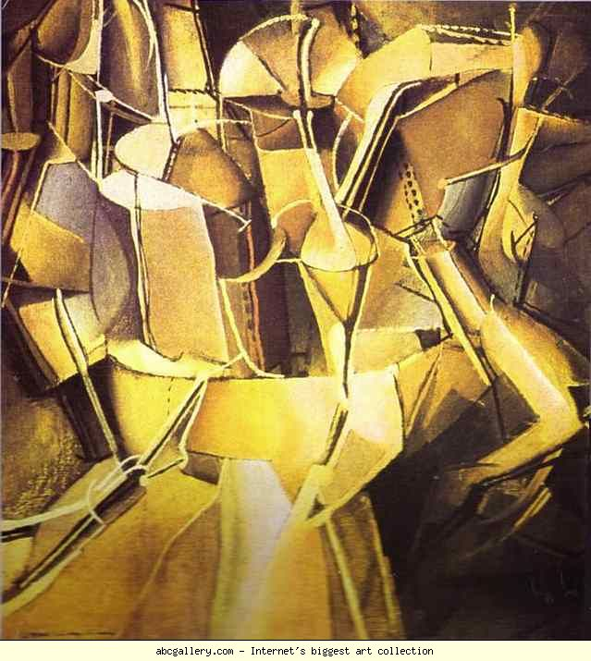
10

Slide 12
James Ensor The Entry of Christ into Brussels, 1888, oil on canvas, 257 x 378 cm
Vincent van Gogh. The Loom. May 1884 Rijksmuseum Krφller-Mόller, Otterlo
Michelangelo. The Sibyl of Delphi. 1508-1512. Sistine Chapel, Vatican
Alexander Rodchenko Dance. An Objectless Composition, 1915
Robert Ryman"Untitled," 1959 7 x 7 1/4 inches. Private Collection
Wassily Kandinsky. On Points. 1928.140 x 140 cm. Musée National d'Art Moderne, Centre Georges Pompidou, Paris, France
Robert Smithson Broken Circle, Emmen, The Netherlands
William Turner. Arundel Castle, with Rainbow. c.1824. British Museum, London, UK
Marcel Duchamp. Bicycle Wheel/Roue de bicyslette. 1913. Private collection
Marcel Duchamp. Transition of Virgin into a Bride/Le Passage de la Vierge à la Mariée. 1912. Canvas 59 x 53.5 cm. The Museum of Modern Arts, New York, NY, USA.

