Slide 1
Artists 19

Slide 2
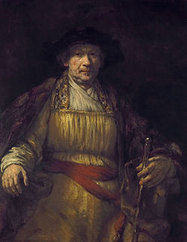
1

Slide 3
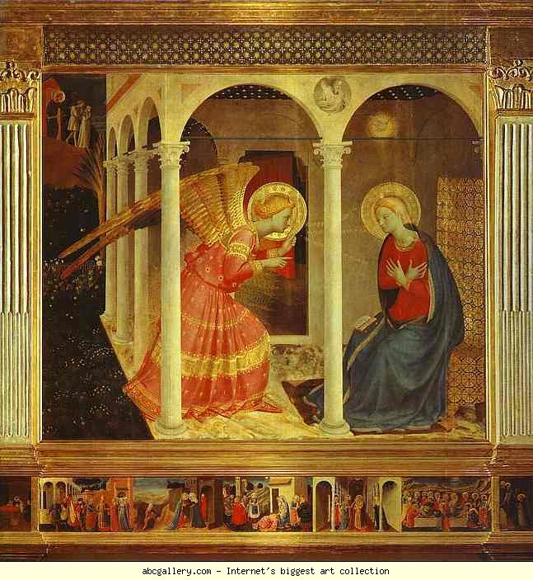
2

Slide 4
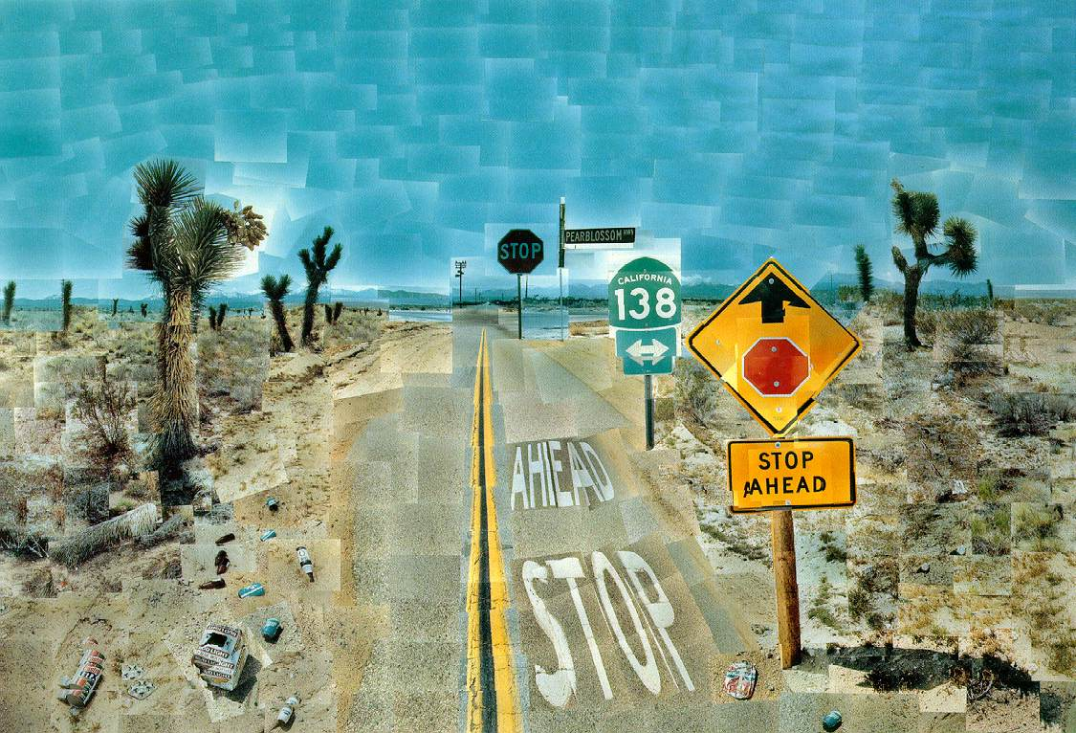
3

Slide 5
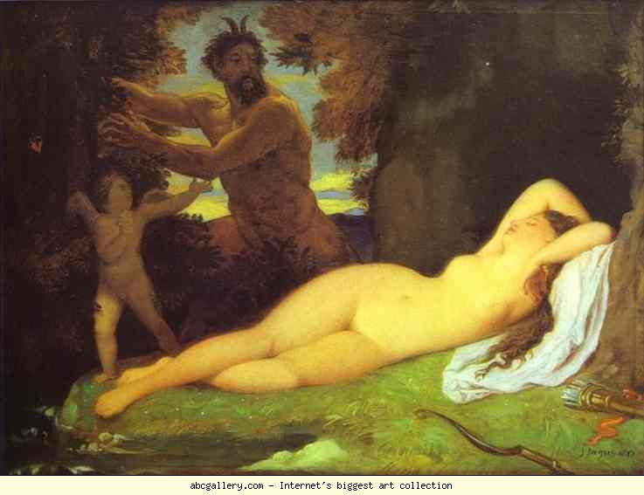
4

Slide 6
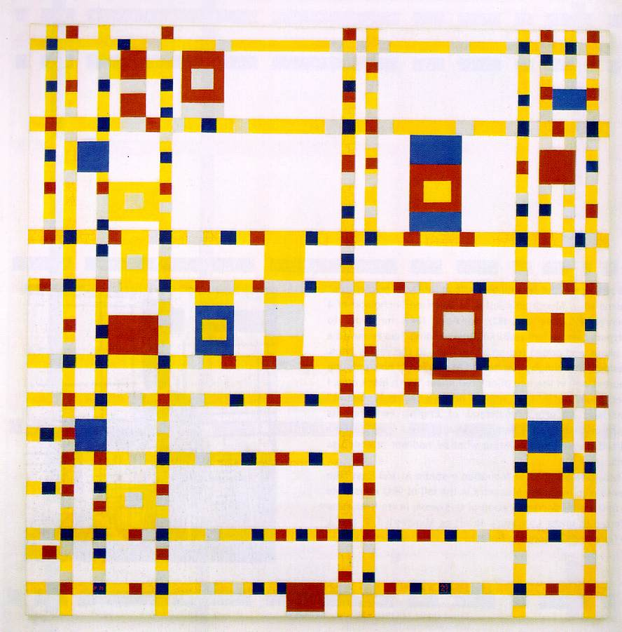
5

Slide 7
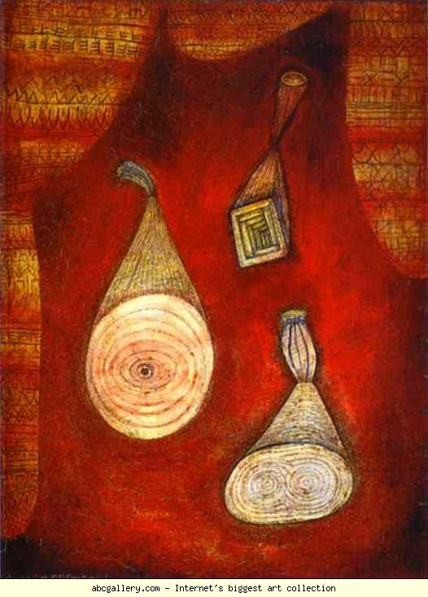
6

Slide 8
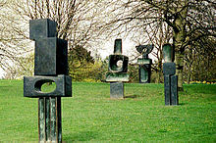
7

Slide 9
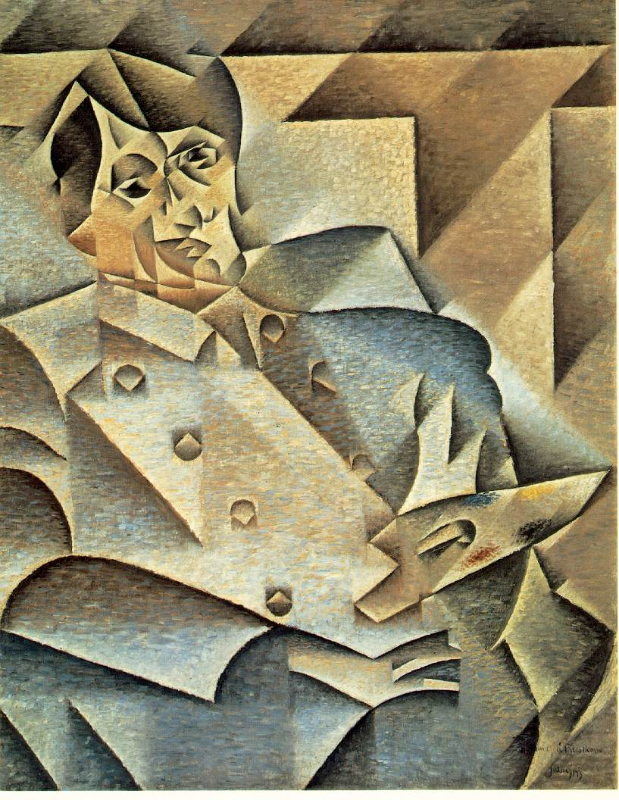
8

Slide 10
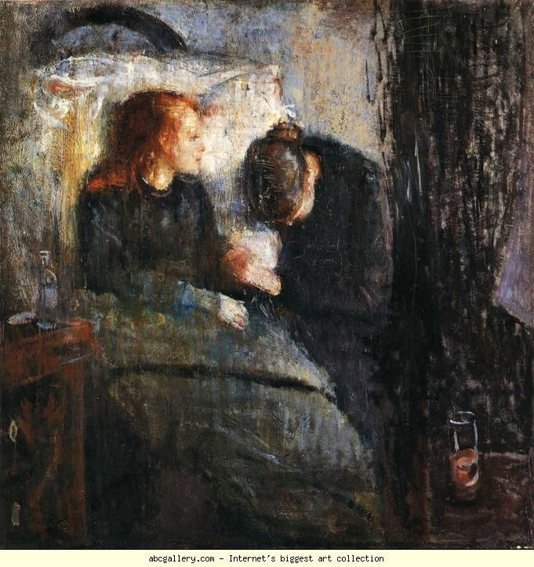
9

Slide 11
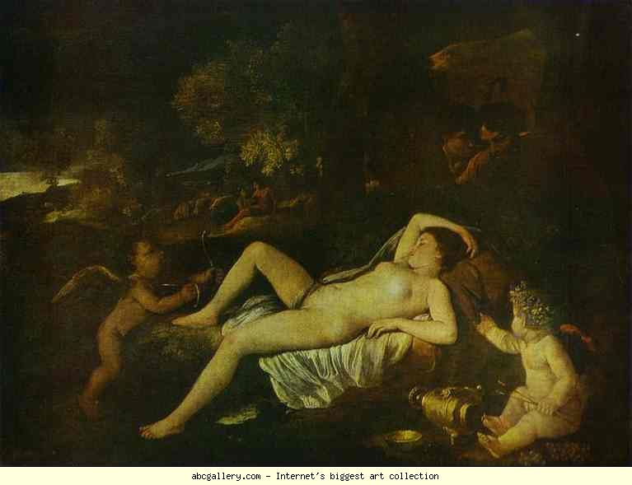
10

Slide 12
Rembrandt Αυτοπροσωπογραφία, 1658 131,5 x 104 εκ., Frick Collection, Νέα Υόρκη
Fra Angelico. Annunciation. c.1432-1434. Tempera on panel. 175 x 180. Museo Diocesano, Cortona, Italy
Hockney, David Pearblossom Highway, 11-18th April 1986 #2 198 x 282 cm Collection the artist
Jean-Auguste-Dominique Ingres. Jupiter and Antiope. 1851. Oil on canvas. Musιe d'Orsay, Paris, France. Deposit from the Louvre.
Mondrian Broadway Boogie Woogie 1942-43 127 x 127 cm The Museum of Modern Art, New York
Paul Klee. Attrappen (Omega 5),. 1927. Oil and watercolor on cadboard. 56.5 x 42.5 cm. Thyssen-Bornemisza Collection, Madrid, Spain
Barbara Hepworth Family of Man (1970), Yorkshire Sculpture Park
Juan Gris portrait of Picasso 1912 93.4 x 74.3 cm Collection of Mrs. and Mrs. Leigh Block, Art Institute of Chicago
Edvard Munch. The Sick Child. 1885-86. Oil on canvas. 119.5 x 118.5 cm. Nasjonalgalleriet, Oslo, Norway
Nicolas Poussin. The Sleeping Venus and Cupid. c.1630. Oil on canvas. Alte Meister Gallerie, Dresden, Germany.

