Slide 1
Artists 20

Slide 2
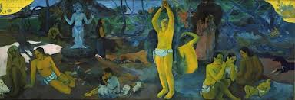
1

Slide 3
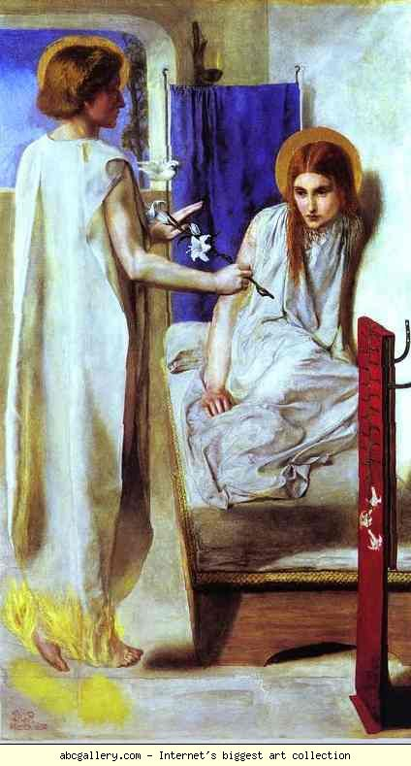
2

Slide 4
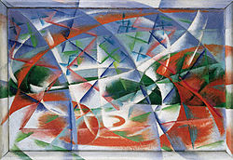
3

Slide 5
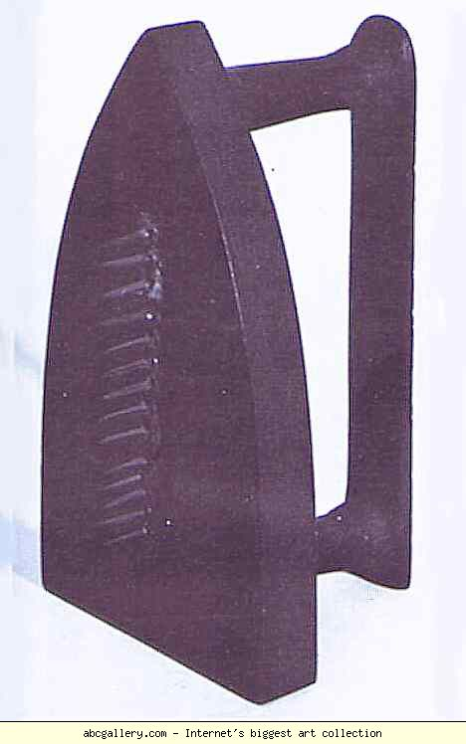
4

Slide 6
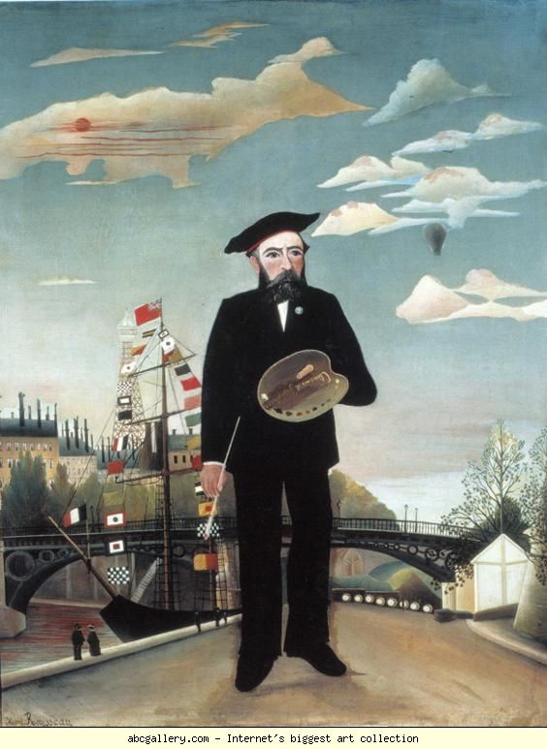
5

Slide 7
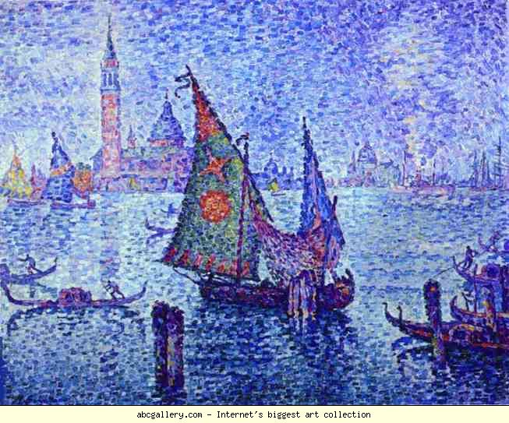
6

Slide 8
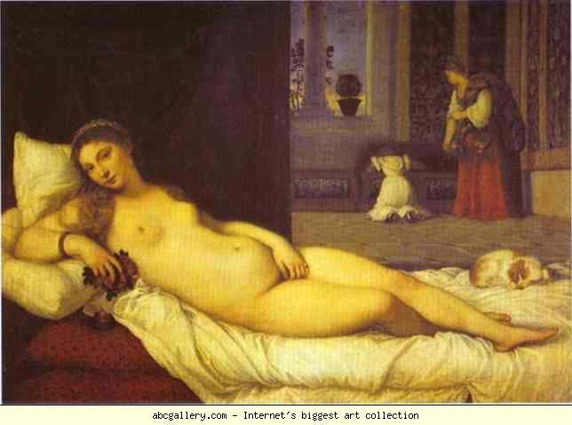
7

Slide 9
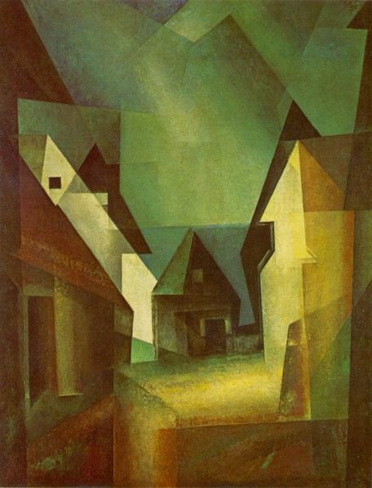
8

Slide 10
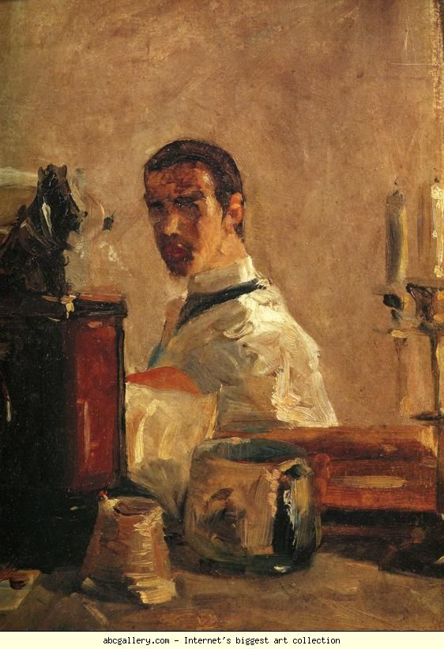
9

Slide 11
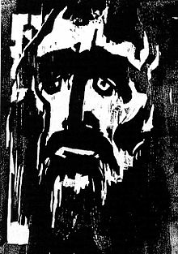
10

Slide 12
Paul GauguinWhere Do We Come From? What Are We? Where Are We Going?, 1897, Boston Museum of Fine Arts, Boston, MA, USA
Dante Gabriel Rossetti. Ecce Ancilla Domini "The Annunciation". 1850. Tate Gallery, London, UK
Giacomo Balla, Abstract Speed + Sound 1913-1914
Man Ray. Gift. Replica of a lost 1921 original. Private collection
Henri Rousseau. Myself, Portrait-Landscape. 1890. 146 x 113 cm. Narodni Gallery, Prague, Czech Republic
Paul Signac. The Green Sail, Venice. 1904. 65 x 81 cm. Musée d'Orsay, Paris, France.
Titian. Venus of Urbino. 1538. Galleria degli Uffizi, Florence, Italy
Lyonel Feininger 'Gaberndorf II', 1924
Henri de Toulouse-Lautrec. Self-Portrait. 40.5 x 32.5 cm. Musée Toulouse-Lautrec, Albi, France
Emil Nolde The Prophet, 1912 Karl-Ernst-Osthaus-Museum, Hagen

