Slide 1
Artists 22

Slide 2
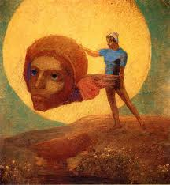
1

Slide 3
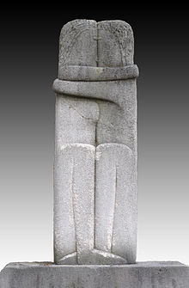
2

Slide 4
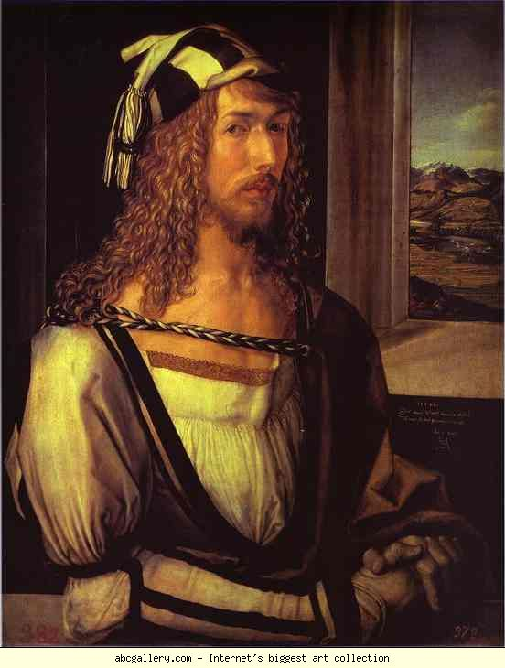
3

Slide 5
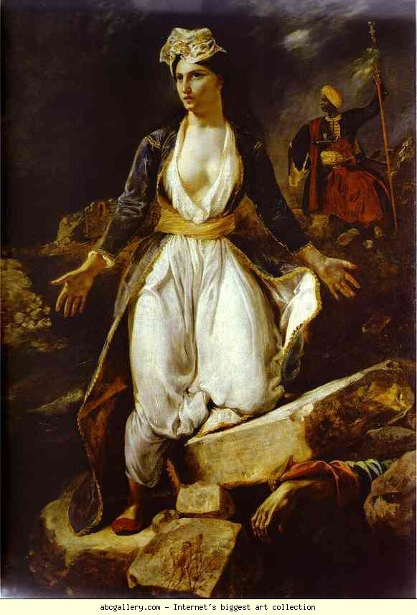
4

Slide 6
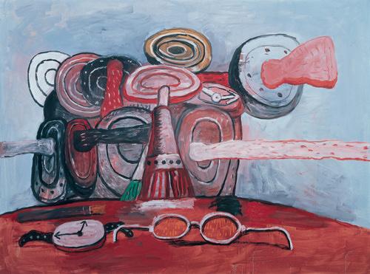
5

Slide 7
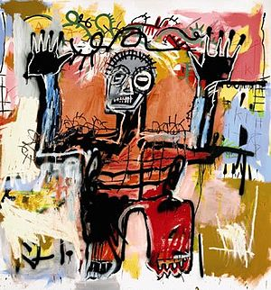
6

Slide 8
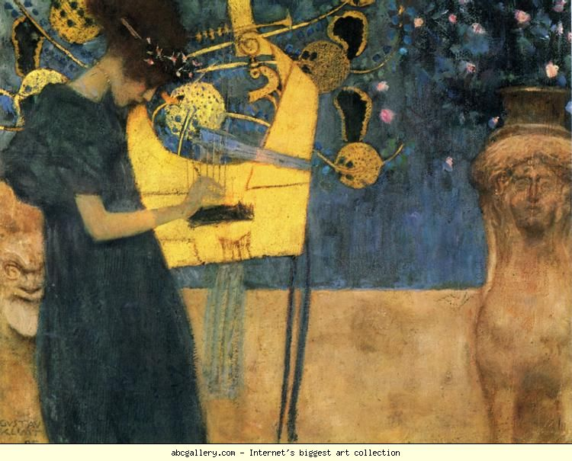
7

Slide 9
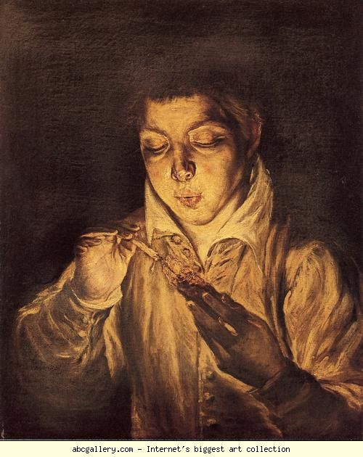
8

Slide 10
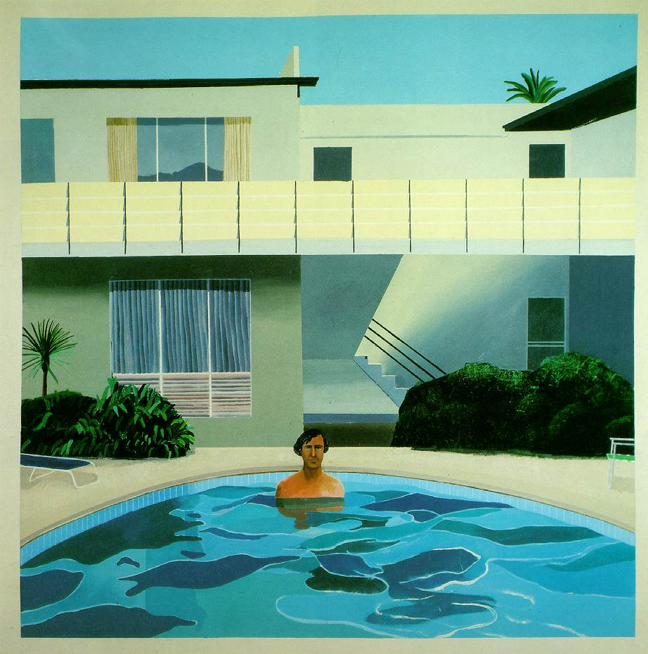
9

Slide 11
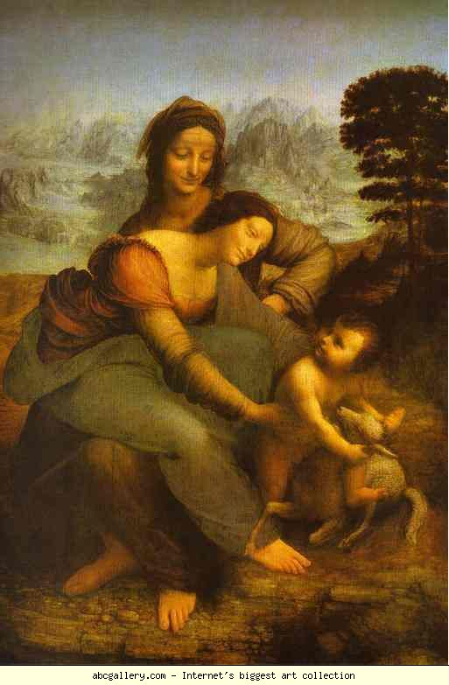
10

Slide 12
Odilon Redon, Η Πτώση του Ίκαρου 1880, Rothschild Art Foundation, Pikesville, MD, USA
Constantin Brâncuși, 1909, Le Baiser (The Kiss), 89.5 x 30 x 20 cm, Cimetière de Montparnasse, Paris
Albrecht Durer. Self-Portrait at 26. 1498. Museo del Prado, Madrid, Spain
Delacroix. Greece on the Ruins of Missolonghi. 1826. Musιe des Beaux-Arts, Bordeaux, France.
Philip Guston. As It Goes, 1978 193 x 259.1 cm. Doris and Donald Fisher Collection at SFMOMA
Jean-Michel Basquiat Untitled 1981
Gustav Klimt. Music. 1895. 37 x 44.5 cm. Bayerische Staatsgemaldesammlungen, Neue Pinakothek, Munich, Germany
El Greco. Boy Lighting a Candle (Boy Blowing on an Ember). c.1570-1575. Private collection
Hockney, David Portrait of Nick Wilder 1966 183 x 183 cm Private collection
Leonardo da Vinci. Virgin and Child with St. Anne. c.1502-1516. Louvre, Paris, France.

