Slide 1
Artists 7

Slide 2
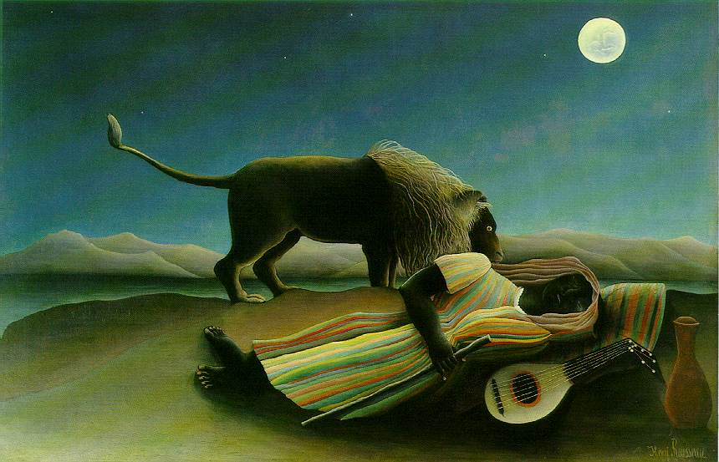
1

Slide 3
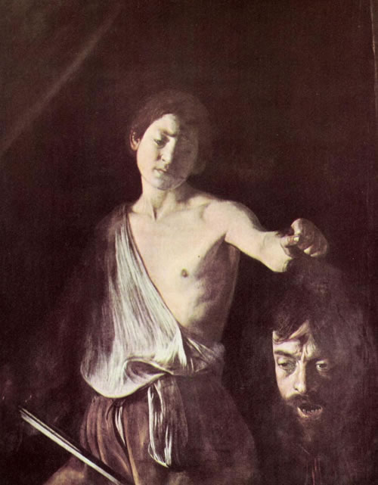
2

Slide 4
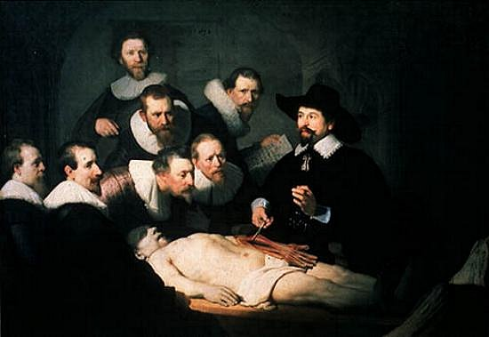
3

Slide 5
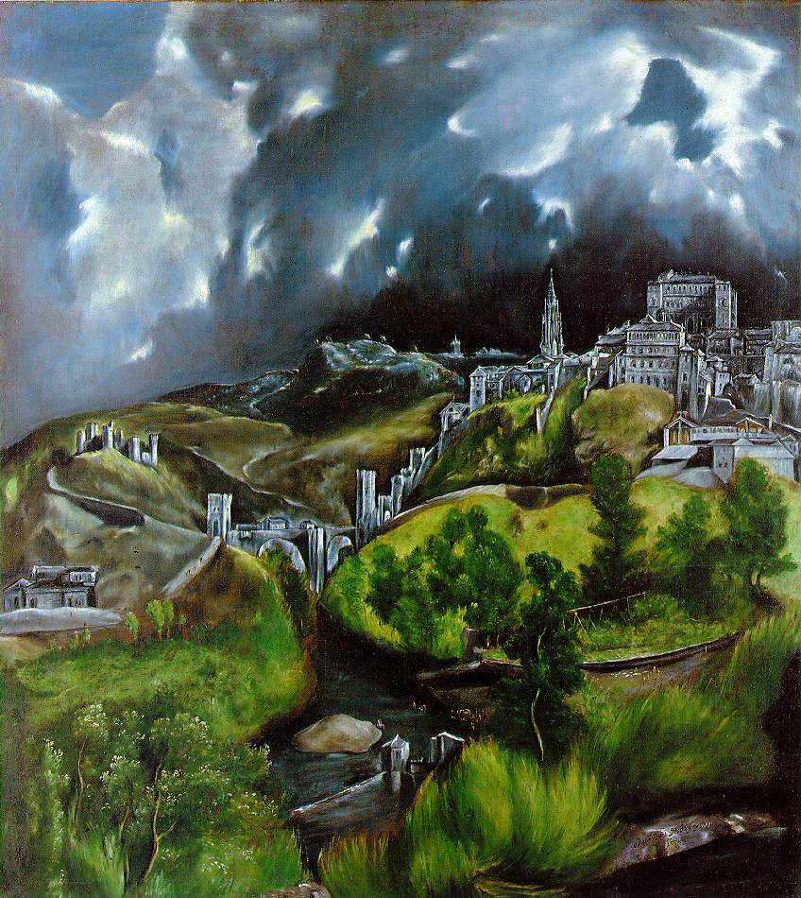
4

Slide 6
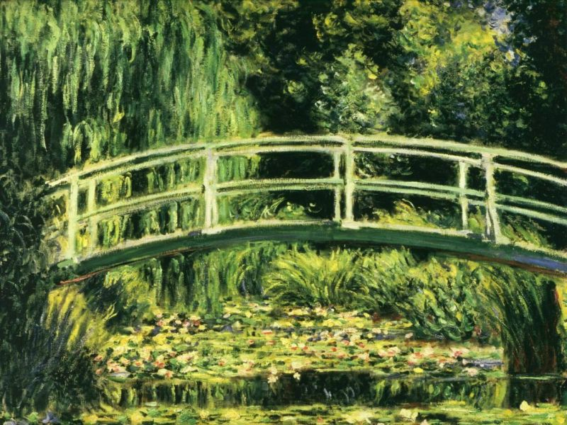
5

Slide 7
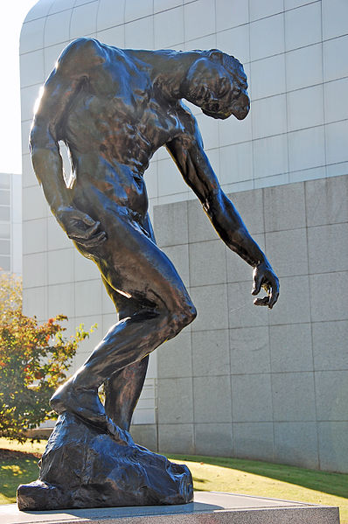
6

Slide 8
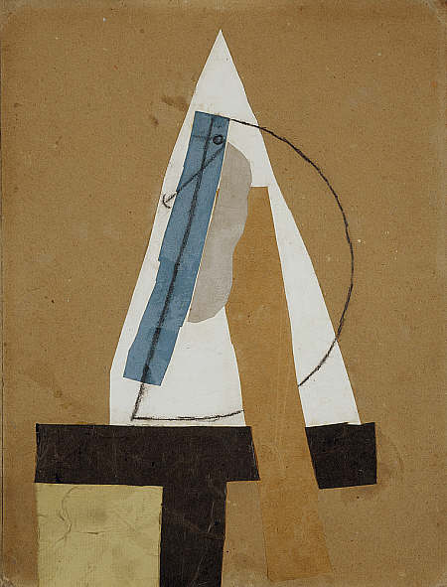
7

Slide 9
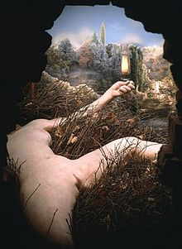
8

Slide 10
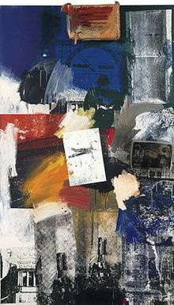
9

Slide 11
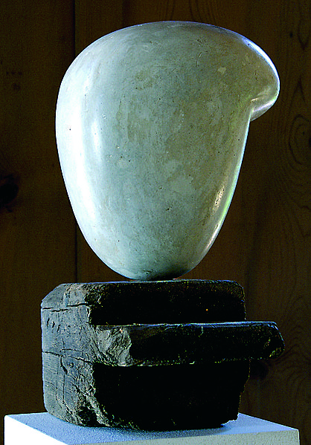
10

Slide 12
Rousseau: Sleeping Gypsy (1897) - Museum of Modern Art, New York
Caravaggio: Davide/ Galea (1607) - Kunsthistorische Muzeum, Wien
Rembrandt: Anatomy Lesson of Dr Nicolaes Tulp (1632) - Mauritshuis, Den Haag
Greco: Toledo (1599) - Metropolitan Museum of Art, New York
Monet: Nimphee (1926) - Orangerie, Paris
Auguste Rodin The Shade, High Museum of Art, Atlanta
Picasso 1913-14, Head (Tête), 43.5 x 33 cm, Scottish National Gallery of Modern Art, Edinburgh
Marcel Duchamp Étant donnés, 1946–1966, mixed media, Philadelphia Museum of Art.
Robert Rauschenberg, untitled "combine," 1963.
Brâncuși, Portrait of Eileen Lane c. 1922

