Slide 1
Artists 8

Slide 2
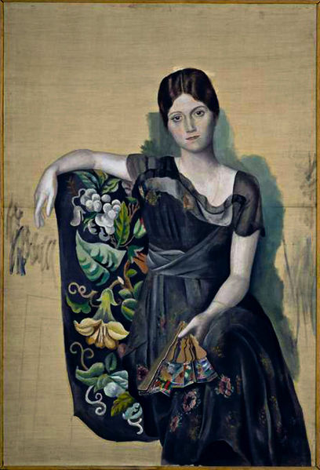
1

Slide 3
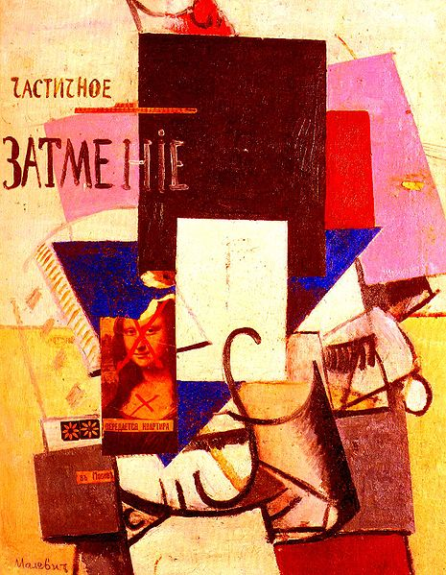
2

Slide 4
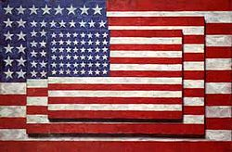
3

Slide 5
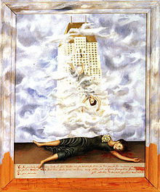
4

Slide 6
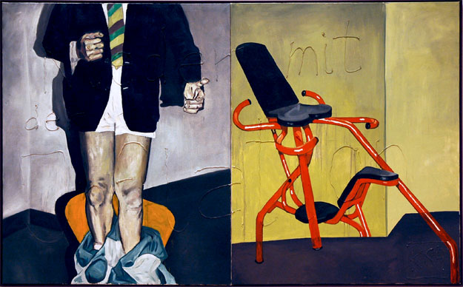
5

Slide 7
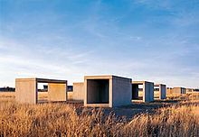
6

Slide 8
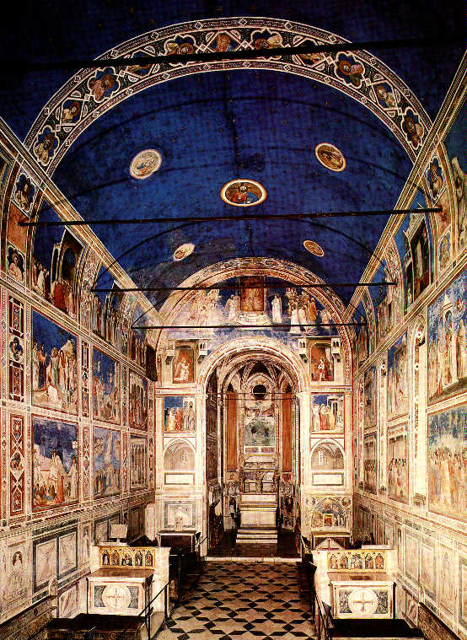
7

Slide 9
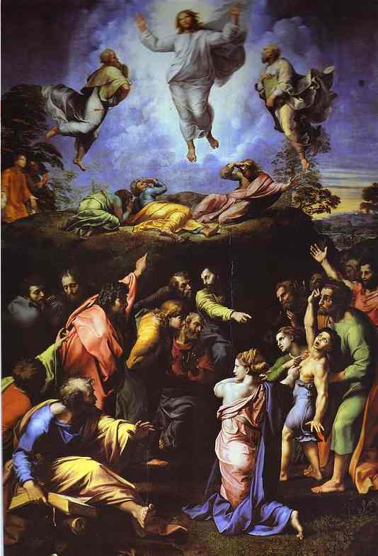
8

Slide 10
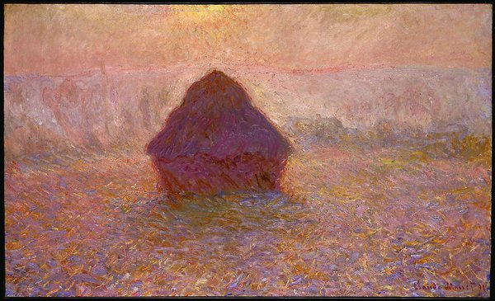
9

Slide 11
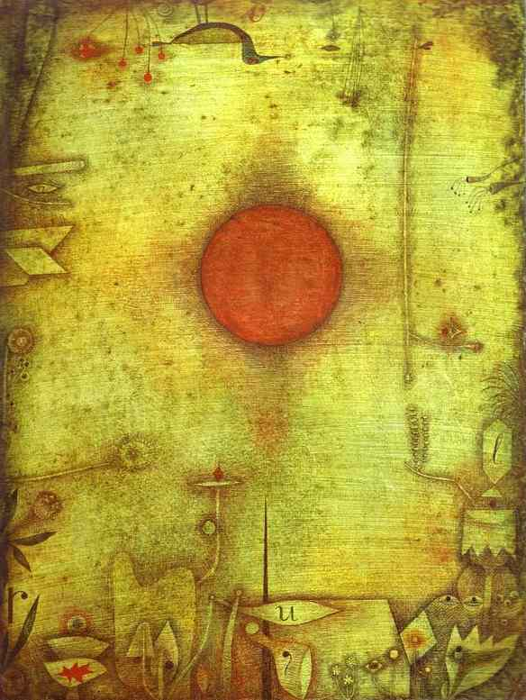
10

Slide 12
Picasso Portrait d'Olga dans un fauteuil (Olga in an Armchair), 1917-18, Musée Picasso, Paris, France
Kazimir Malevich "Composition with the Mona Lisa," 1914 Private collection.
Jasper Johns Three Flags, 1958, Whitney Museum of American Art
Frida Kahlo, The Suicide of Dorothy Hale, 1939, Oil on masonite, 60.4 × 48.6 cm. – The Phoenix Art Museum
Martin Kippenberger Down with inflation 1984 oil and silicone on canvas (2 parts) 63" x 104.75" each
Donald Judd Untitled (1980–84), Chinati Foundation, Marfa
Giotto: Cappella degli Scrovegni, Padova (1305)
Raffaello: Trasfigurazione (1519) - Pinacoteca Vaticana, Roma
Monet: The Grainstack (1896) - Museum of Fine Arts, Boston
Klee: Ad Marginen (1930) - Kunstmuseum, Basel

