Slide 1
Artists 9

Slide 2
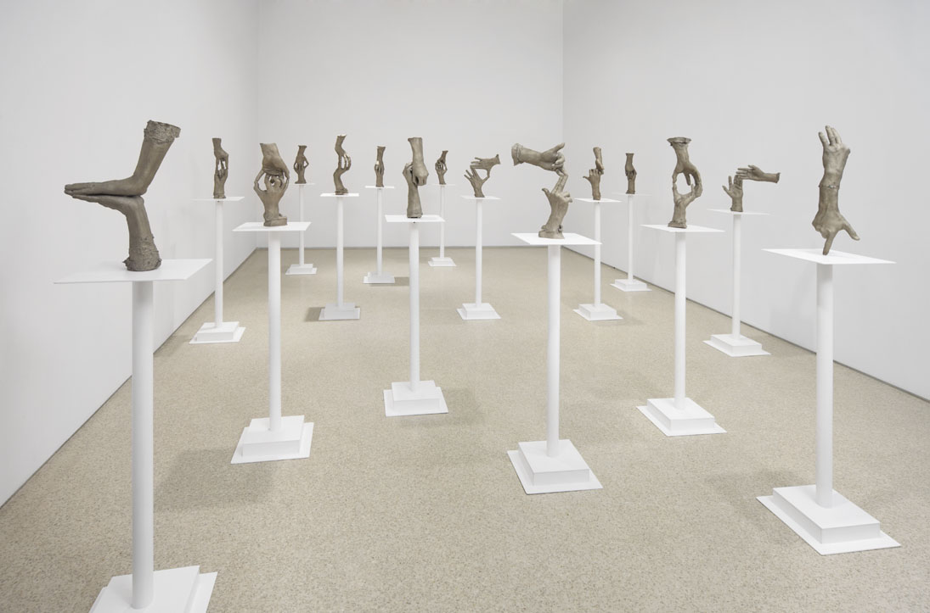
1

Slide 3
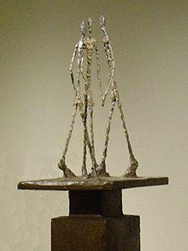
2

Slide 4
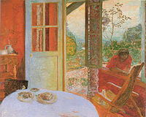
3

Slide 5
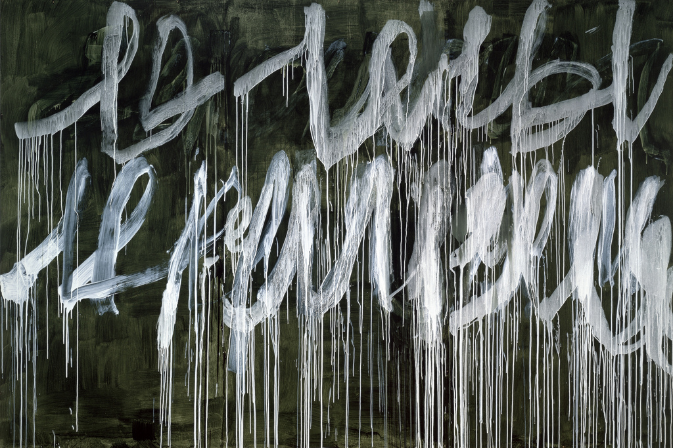
4

Slide 6
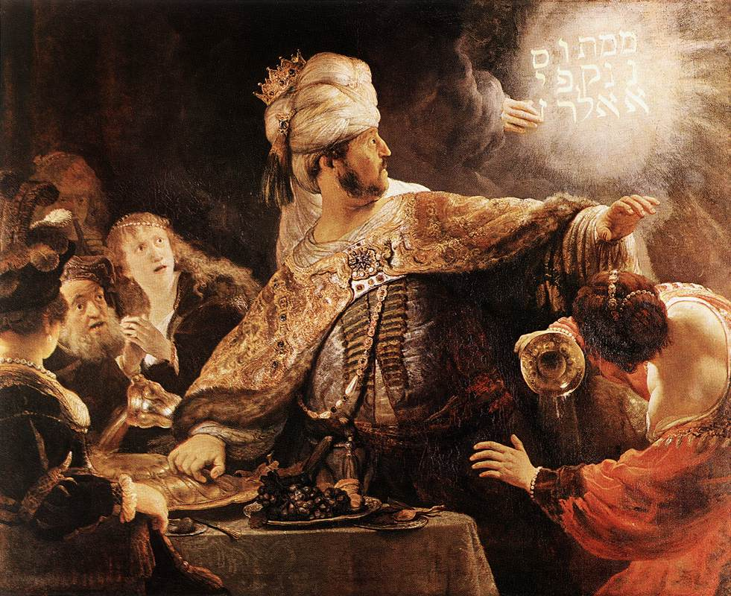
5

Slide 7
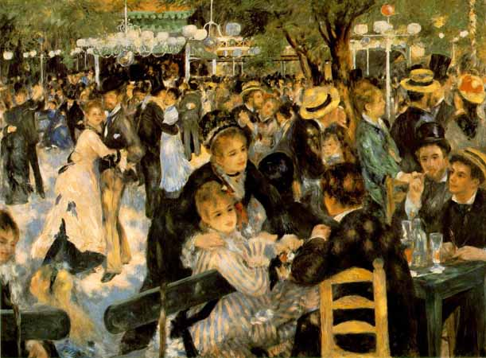
6

Slide 8
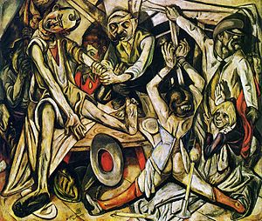
7

Slide 9
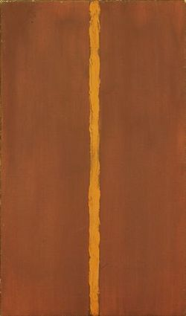
8

Slide 10
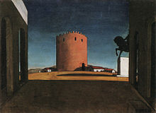
9

Slide 11
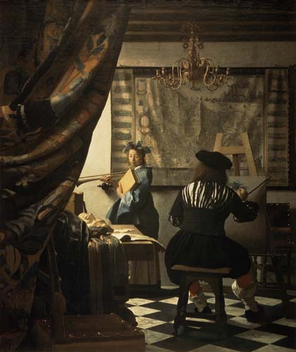
10

Slide 12
Bruce Nauman, Fifteen Pairs of Hands, 1996, 15 parts each: approx. 52 x 12 x 12 inches, Collection The Glenstone Foundation, Courtesy Sperone Westwater, New York
Alberto Giacometti Three Men Walking II, 1949, Metropolitan Museum of Art.
Pierre BonnardThe Dining Room in the Country(1913), oil on canvas, Minneapolis Institute of Arts
Edwin Parker "Cy" TwomblyIII NOTES FROM SALALAH, NOTE III, 2005-07. / ACRYLIC ON WOOD PANEL 243.8 X 365.8 CM
Rembrandt: Belshazzar's Feast (1635) - National Gallery, London
Renoir: Bal du Moulin de la Galette (1876) - Musee National d'Orsay, Paris
Max Beckmann, 1918-19, The Night (Die Nacht), oil on canvas, 133 x 154 cm, Kunstsammlung Nordrhein-Westfalen, Düsseldor
Barnett Newman Onement 1, 1948. Museum of Modern Art, New York.
Giorgio de ChiricoThe Red Tower (1913), Peggy Guggenheim Collection
Vermeer: Malkunst (1666) - Kunsthistorische Muzeum, Wien

