Slide 1
Artists

Slide 2
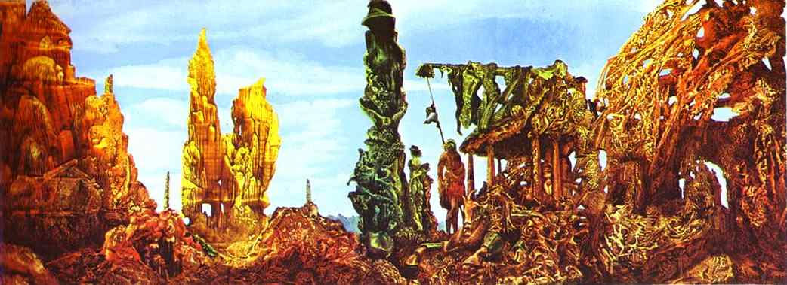
1

Slide 3
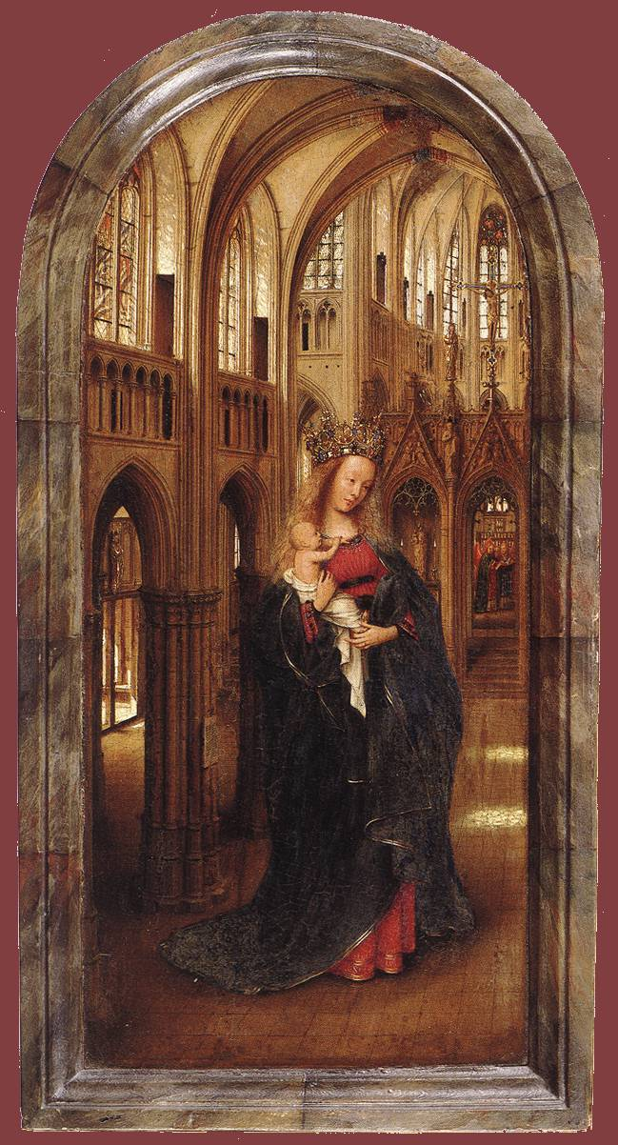
2

Slide 4
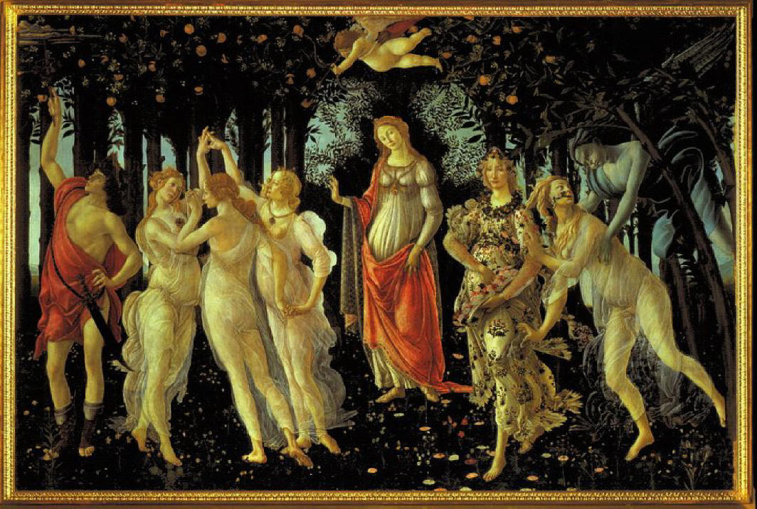
3

Slide 5
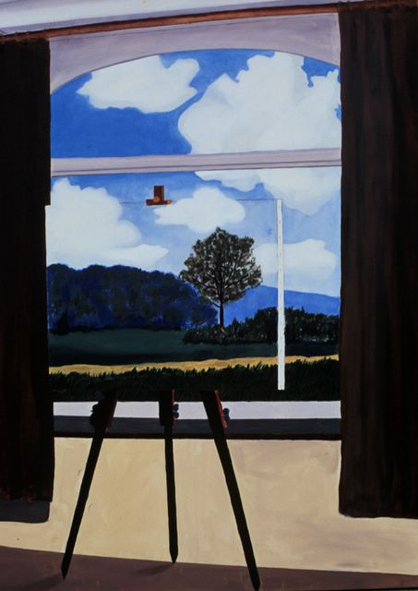
4

Slide 6
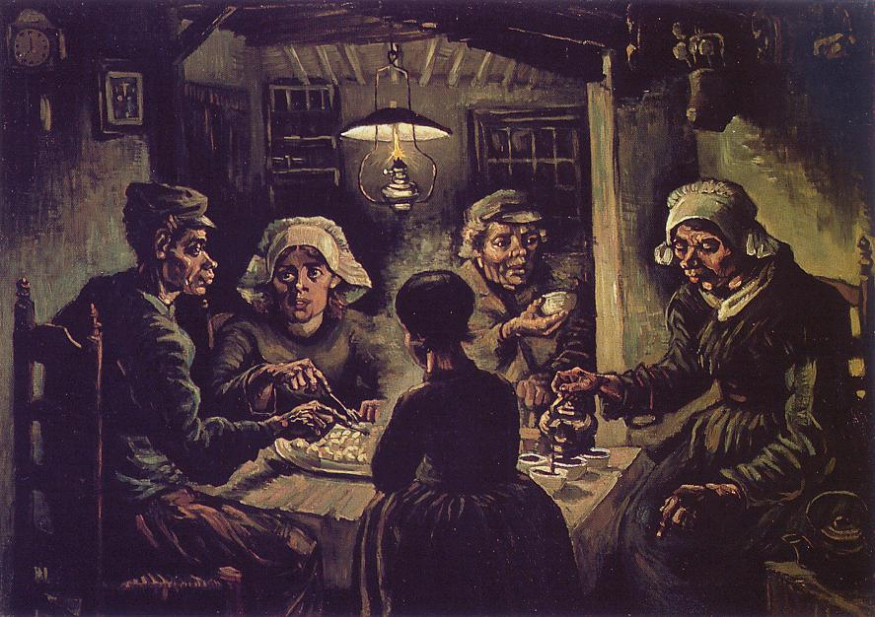
5

Slide 7
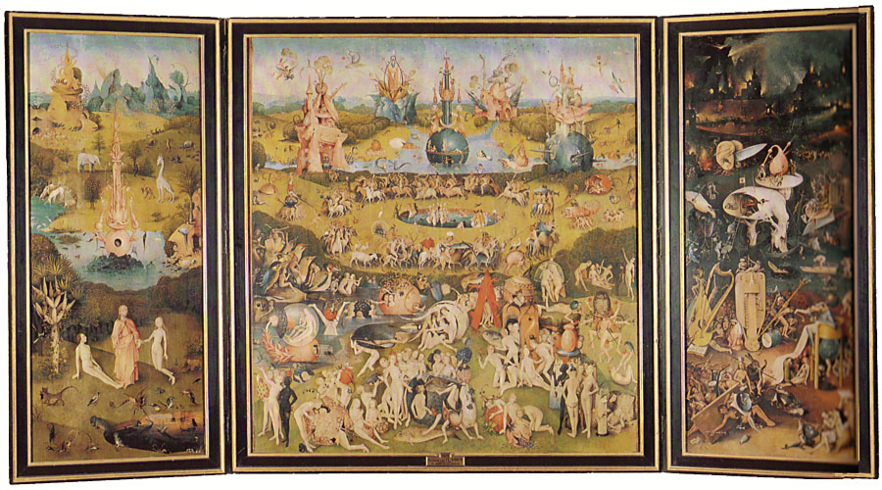
6

Slide 8
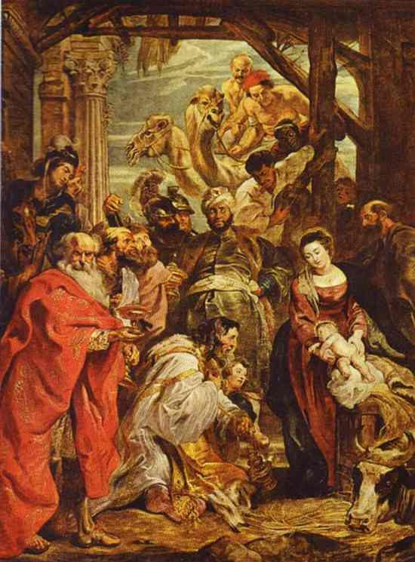
7

Slide 9
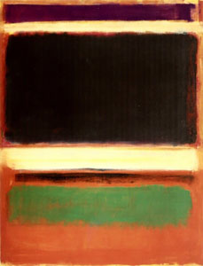
8

Slide 10
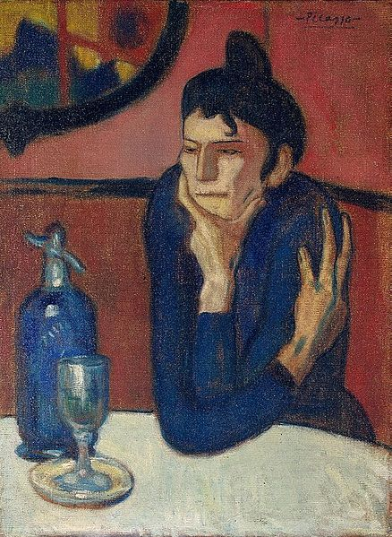
9

Slide 11
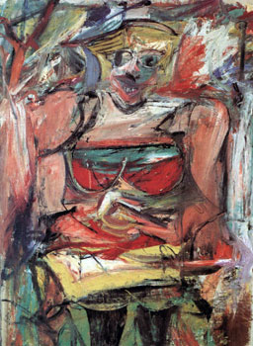
10

Slide 12
Ernst: Europe After the Rain II (1942) - Sumner Collection, Hartford
Van Eyck: Madonna in the Church (1425) - Gemaldegalerie, Berlin
Botticelli: Allegoria della Primavera (1478) - Uffizi, Firenze
Magritte: Condition Humain (1934) - National Gallery, Washington
Van Gogh: Potato Eaters (1885) - Van Gogh Museum, Amsterdam
Bosch: The Garden of Delights (1504) - Prado, Madrid
Rubens: The Adoration of the Magi, Prado, Madrid
Mark Rothko No. 3/No. 13 (Magenta, Black, Green on Orange), 1949,216.5 × 164.8 cm,Museum of Modern Art.
Picasso 1901-02,Femme au café (Absinthe Drinker), 73 x 54 cm, Hermitage Museum, Saint Petersburg, Russia
Willem de Kooning, Woman V (1952–53),National Gallery of Australia

