Slide 1
…10 more

Slide 2
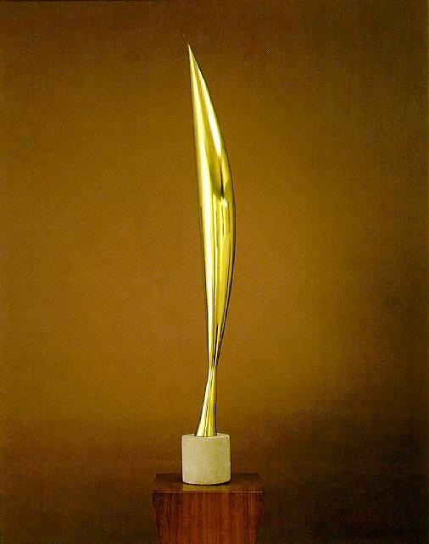
1

Slide 3
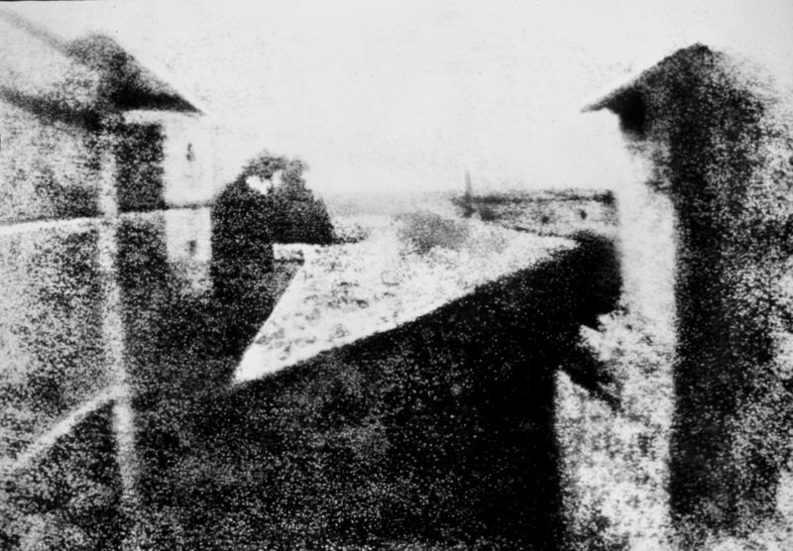
2

Slide 4
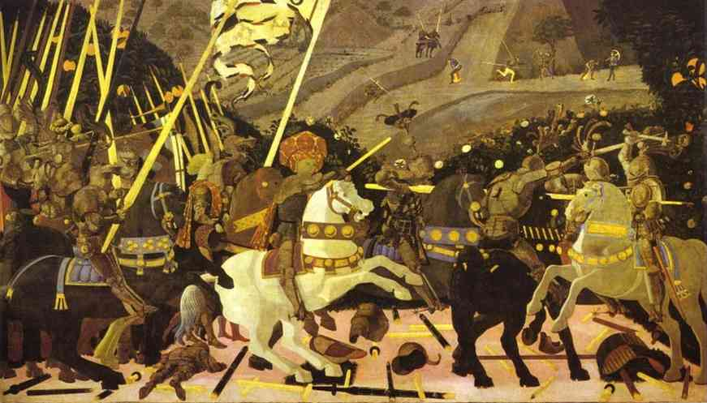
3

Slide 5
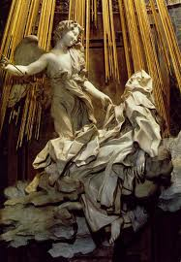
4

Slide 6
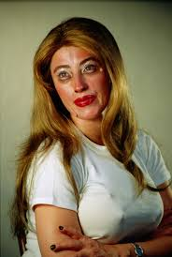
5

Slide 7
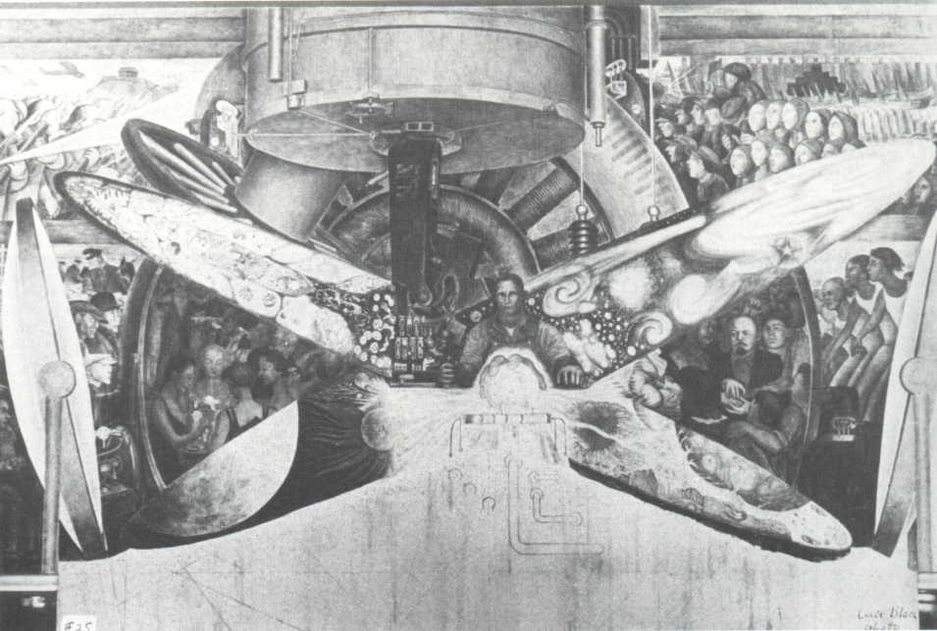
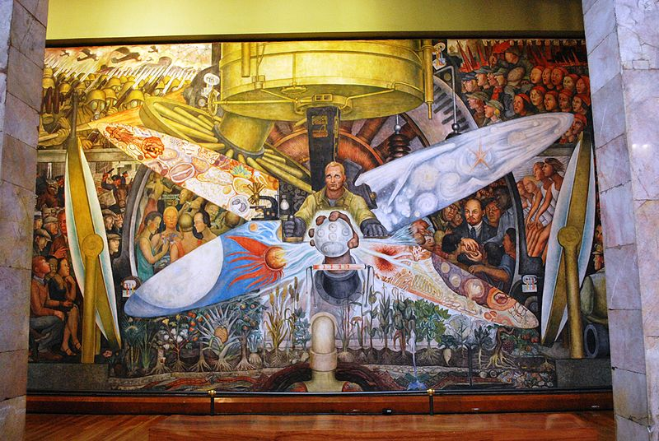
6

Slide 8
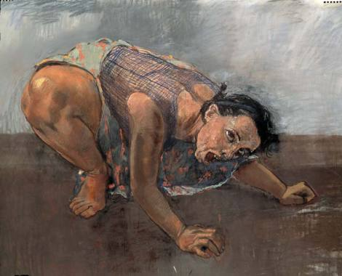
7

Slide 9
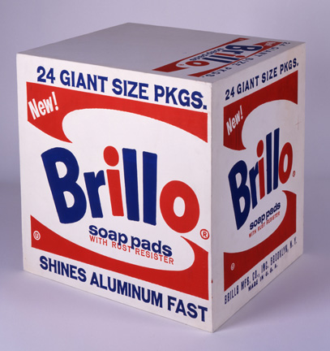
8

Slide 10
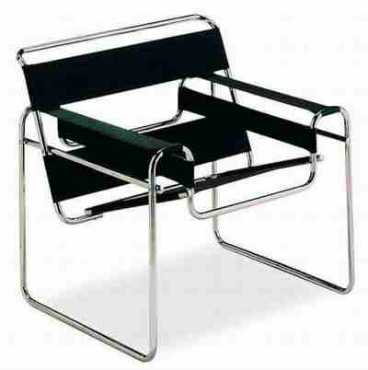
9

Slide 11
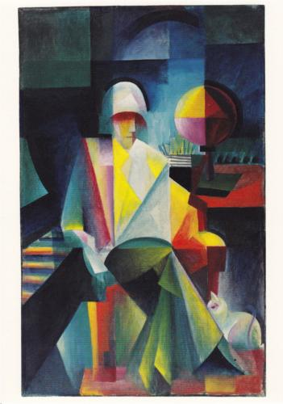
10

Slide 12
Constantin Brancusi, Bird in Space , (MoMA)
Joseph Nicéphore Niépce, World's First Photograph 1826
Paolo Uccello: Battaglia di San Romano/Part II (1456) - National Gallery, London
Η Έκσταση της Αγίας Θηρεσίας (1646), Παρεκκλήσι Κορνάρο, Σάντα Μαρία ντέλα Βιτόρια
Cindy Sherman, Untitled #359, 2000
Diego Rivera Man at the Crossroads, fresco in the Rockefeller Center , New York,1934
Paola Rego, Dog Woman1994, Pastel on canvas120 x 160 cm
Andy Warhol, Brillo Soap Pads Box , 1964ilkscreen ink on synthetic
polymer paint on wood, 17 x 17 x 14 in. Andy Warhol Museum, Pittsburgh Founding Collection.
Marcel Breuer ,Wassily armchair 1925
Johannes Itten, Der Bachsänger Helge Lindberg, 1916

